Slide 1
User/Provider Build
Galen Healthcare Solutions

Slide 2
Questions and Answers
You will be muted
Please save your questions for Q+A at the end of the presentation
Feel free to submit questions via the Q+A panel to the left
We will try to get to them all at the end of the presentation

Slide 3
Today’s Agenda
Learn to read a cheatsheet
User/Provider Setup
TWUser Admin
Work Def Admin
Task Admin
Security Admin
Provider Admin
Charge Admin
Group Admin
Scan Setup

Slide 4
Things We Will Need
To build a provider, we need a few pieces of information
NPI
DEA number and expiration date
State license number and expiration date
Sites the provider will be working
Primary Specialty
PMS code

Slide 5
Hands On
Let’s head into the application and get to building!

Slide 6
Setting Up Users in Scan
Set Password
Select Security Group
Set Default Task Basket
Link Task Basket to Self

Slide 7
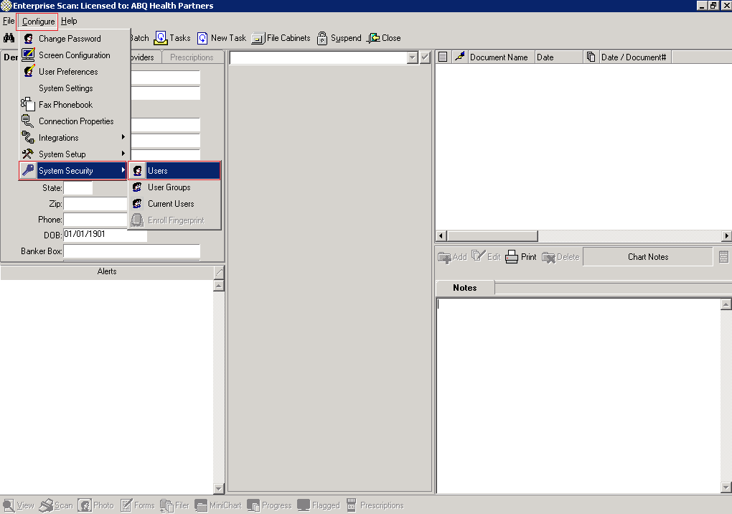
Set Password, Select Security Group, and Set Default Task Basket
Step 1: Configure > System Security > Users

Slide 8
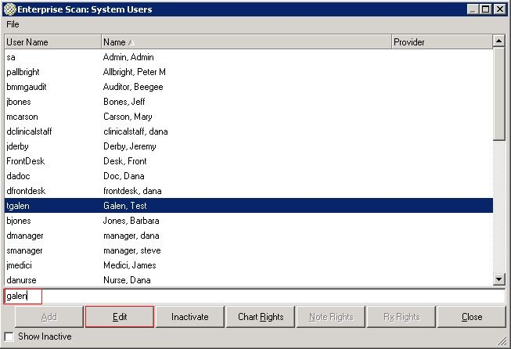
Set Password, Select Security Group, and Set Default Task Basket
Step 2: Search for user by last name, highlight user, and click ‘Edit’ button

Slide 9
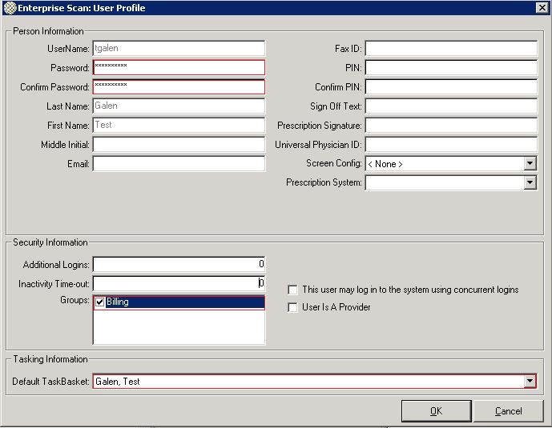
Set Password, Select Security Group, and Set Default Task Basket
Step 3: Set password, confirm password, select security group, and set default task basket

Slide 10
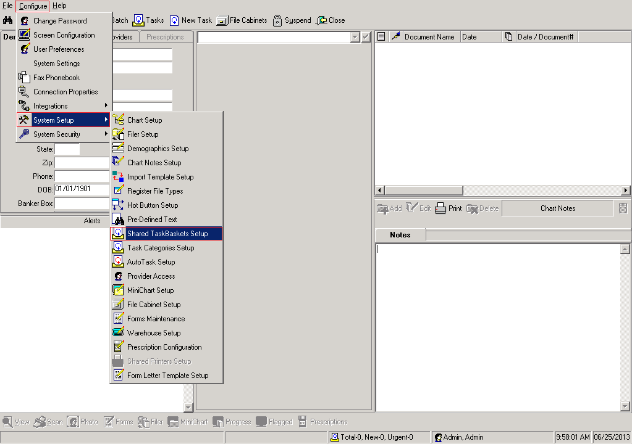
Link Task Basket To Itself
Step 1: Configure > System Setup > Shared TaskBaskets Setup

Slide 11
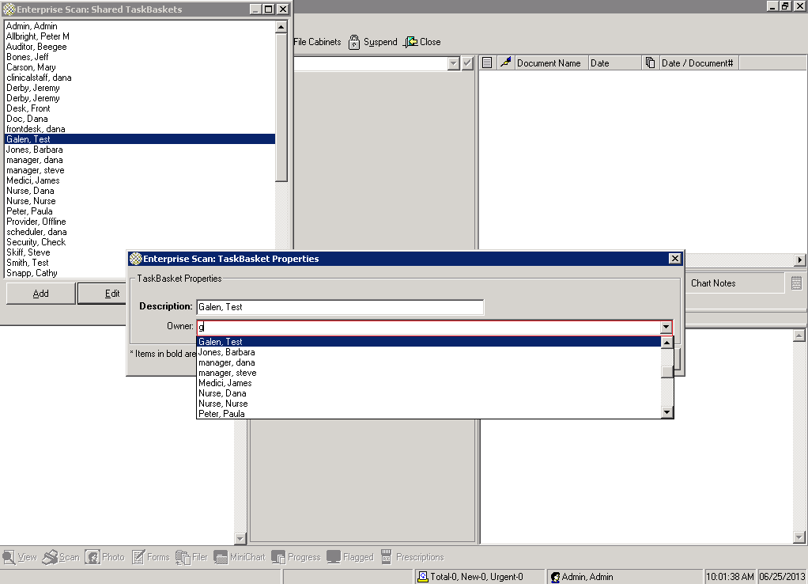
Link Task Basket To Itself
Step 2: Find user from dropdown, highlight user, click ‘Edit’ button, search for user in ‘Owner’ dropdown,
and click ‘OK’ button

Slide 12
Questions and/or Comments?

Slide 13
Galen Resources
If you have any questions regarding this webcast or any other educational materials from Galen, please e-mail education@galenhealthcare.com
Visit galenhealthcare.com to check out our wiki, blogs, and services/products

