Slide 1

Health IT Security

Slide 2


Slide headline
Solving for Today. Preparing for Tomorrow.
Your phone has been automatically muted. Please use the Q&A panel to ask questions during the presentation!

Slide 3
Slide headline
Agenda
Legal Timeline
Current Law
Threats
General Best Practices
The Cloud!
ISV Evaluation
© 2016 Galen Healthcare Solutions

Slide 4
Slide headline
Legal Timeline
HIPAA Signed Into Law
ARRA Signed (+HITECH Act)
8/21/1996
2/17/2009
1996
1998
2000
2002
2004
2006
2008
2010
2012
2013
3/13/2006
9/23/2013
HIPAA Fully Enforced (Security, Privacy, Tx/Codesets)
Final Deadlines of Compliance for CE/BA
3/26/2013
Omnibus Final Rule In Effect
1/17/2013
Omnibus Rule Final
9/23/2010
Data Breach Notification Rule Enforcement
© 2016 Galen Healthcare Solutions
Notes:
Source: https://www.aap.org/en-us/professional-resources/practice-support/practice-management/HIPAA/Pages/HIPAA-Overview.aspx

Slide 5

Slide headline
Current Law
Omnibus Rules Take Precedence
  Breach Notification
  Business Associates
  Penalties
  Privacy Rules
  Teeth
© 2016 Galen Healthcare Solutions
Notes:
http://conference.himss.org/HIMSS13/pdfs/7.pdf

Slide 6
Slide headline
Breach Notification
No thresholds for reporting (used to be 500+)
Virtually all breaches are now reportable
Risk analysis can mitigate exposure
© 2016 Galen Healthcare Solutions
Notes:
Reference: http://www.poynerspruill.com/publications/Pages/SummaryofNewHIPAARules.aspx
https://ocrportal.hhs.gov/ocr/breach/wizard_breach.jsf

Slide 7
Slide headline
Business Associates
Mostly the same rules apply as to Covered Entities
  All of the Security Rule
  Most of the Privacy Rule
  (if contract involves Privacy Rule obligations)
Many BAAs needed to be updated
  Specifically note Security & Privacy Rule adherence
  Specify any delegation of Privacy Rule compliance
© 2016 Galen Healthcare Solutions
Notes:
http://wedi.org/forms/uploadFiles/35FE700000100.filename.7.26_Combined.pdf

Slide 8
Slide headline
Business Associates
BAs are contractually AND directly liable for violations
BAs liable regardless of contract with CE
BAs are liable for the actions of their sub-contractors
Subcontractors are BAs
CE is ultimately responsible as well
© 2016 Galen Healthcare Solutions
Notes:
http://wedi.org/forms/uploadFiles/35FE700000100.filename.7.26_Combined.pdf

Slide 9
Slide headline
Penalties
Didn’t Know: $100-$50k per patient
Reasonable: $1k-$50k per patient
Willful/Corrected: $10k-$50k per patient
Willful/Uncorrected: $50k per patient
Yearly Max Per Calendar Year: $1.5mm
(For same provision)
© 2016 Galen Healthcare Solutions
Notes:
https://www.federalregister.gov/articles/2013/01/25/2013-01073/modifications-to-the-hipaa-privacy-security-enforcement-and-breach-notification-rules-under-the#h-95

Slide 10
Slide headline
Penalties
Worse when policies are missing / inadequate
Intent matters
Entity | Fine | Details
CIGNET | $4.3mm | Online database / significant negligence
Alaska DHHS | $1.7mm | Unencrypted USB drive, few policies / risk analysis
WellPoint | $1.7mm | No AuthN/Z for large DB / significant negligence
BCBS of Tennessee | $1.5mm | 57 unencrypted HDs stolen
Mass Eye & Ear | $1.5mm | Unencrypted laptop stolen / poor policies & risk analysis
Affinity Health Plan | $1.2mm | Lack of proper equipment disposal
South Shore Hospital | $750k | Backup tapes lost in transit
© 2016 Galen Healthcare Solutions
Notes:
https://www.truevault.com/blog/what-is-the-penalty-for-a-hipaa-violation.html

Slide 11
Slide headline
Privacy Rules
Expanded Guidelines
  Marketing / Communications
  Disclosure for purposes
    Remuneration / payment
    Student immunization enforcement
    Health plans
  Privacy policies
© 2016 Galen Healthcare Solutions
Notes:
http://www.hhs.gov/hipaa/for-professionals/privacy/laws-regulations/index.html

Slide 12

Slide headline
Threats
Hacking
Physical theft
Employee / BA misuse
Negligence / loss / etc.
© 2016 Galen Healthcare Solutions

Slide 13
Slide headline
Threats
© 2016 Galen Healthcare Solutions
Notes:
https://ocrportal.hhs.gov/ocr/breach/breach_report.jsf

Slide 14
Slide headline
Threats
© 2016 Galen Healthcare Solutions
Notes:
https://ocrportal.hhs.gov/ocr/breach/breach_report.jsf

Slide 15
Slide headline
Threats
© 2016 Galen Healthcare Solutions
Notes:
https://ocrportal.hhs.gov/ocr/breach/breach_report.jsf

Slide 16
Slide headline
Threats
© 2016 Galen Healthcare Solutions
Notes:
https://ocrportal.hhs.gov/ocr/breach/breach_report.jsf

Slide 17

Slide headline
General Best Practices
Risk Mitigation
  IT
  Physical Security
  Risk Assessments
  Employee Education / Training
  BA / Vendor Selection
Penalty Mitigation
  Documentation!
    Policies
    Risk Assessments
    Meeting minutes
    Demonstrate intent
© 2016 Galen Healthcare Solutions

Slide 18

Slide headline
Risk Mitigation - IT
Encryption
  At rest (BitLocker, Sophos, etc.)
    Includes servers, mobile devices
    Must be able to prove encryption
  In motion (TLS / HTTPS)
    Includes “internal” communications
  Don’t forget 3rd parties
    Email, file sharing, etc.
  Secure the cryptographic keys!
    Consider 3rd party “secrets” service
© 2016 Galen Healthcare Solutions

Slide 19
Slide headline
Risk Mitigation - IT
Infrastructure – The Perimeter
  Firewalls
    Intrusion detection
    Stateful packet inspection & filtering
    Subscription-based updates
  Modern VPNs
    IPSEC or SSL
    Not PPTP
  Restrict WAP
    WPA2/EAP
    Segmented guest networks
© 2016 Galen Healthcare Solutions
Notes:
https://technet.microsoft.com/en-us/library/bb735870.aspx, http://www.gfi.com/blog/the-ultimate-network-security-checklist/

Slide 20
Slide headline
Risk Mitigation - IT
Infrastructure – Inside
    Antivirus/Malware Detection
    Centralized AuthN/Z
      Active Directory / ADFS
      Never share accounts
      Multi-factor whenever possible
      Minimal access profiles
      Industry standard password, lockout, expiration, etc. policies
      Clear off-boarding procedures
    Patching / Change Control
    Restrict USB / external devices
    Network segmentation
    Email
© 2016 Galen Healthcare Solutions
Notes:
https://technet.microsoft.com/en-us/library/bb735870.aspx, http://www.gfi.com/blog/the-ultimate-network-security-checklist/

Slide 21
Slide headline
Risk Mitigation - IT
Infrastructure – Continuity
    Ensure availability of PHI
    Ensure care can be provided
    Highly available servers (clusters, farms, etc.)
    Hot secondary data centers
    Software based continuity solutions
    Backups
        On & off site
        Encrypted
        TEST THE RESTORE!
    Fully documented
© 2016 Galen Healthcare Solutions
Notes:
https://technet.microsoft.com/en-us/library/bb735870.aspx, http://www.gfi.com/blog/the-ultimate-network-security-checklist/

Slide 22
Slide headline
Risk Mitigation – Physical Security
Room / Device Locks
  Secure areas (server rooms, backup storage)
  Desktops, laptops, tablets
  Server cases (case intrusion sensors)
Building Access & Identification
  Front desk / guard
  Keycode / Fob policies (off-boarding)
Beware of Social Engineering
  Walks in, grabs laptop, leaves
  Walks in, drops off malware in USB key, leaves
  Help desk “forgot password” calls
  Phishing via email, social media, etc.
© 2016 Galen Healthcare Solutions
Notes:
https://technet.microsoft.com/en-us/library/bb735870.aspx, http://www.gfi.com/blog/the-ultimate-network-security-checklist/

Slide 23
Slide headline
Risk Mitigation – Risk Assessment
“Conduct an accurate and thorough assessment of the potential risks and vulnerabilities to the confidentiality, integrity, and availability of electronic protected health information held by the [organization].”
- Section 164.308(a)(1)(ii)(A) - Security Rule
© 2016 Galen Healthcare Solutions
Notes:
http://www.hhs.gov/sites/default/files/ocr/privacy/hipaa/administrative/securityrule/rafinalguidancepdf.pdf

Slide 24
Slide headline
Risk Mitigation – Risk Assessment
Done “as needed”
Anytime risks may have changed
Keep full meeting notes
Sign off by PO/SO, CIO, CTO, etc.
Can be done internally or with an outside party
© 2016 Galen Healthcare Solutions
Notes:
http://www.hhs.gov/sites/default/files/ocr/privacy/hipaa/administrative/securityrule/rafinalguidancepdf.pdf

Slide 25
Slide headline
Risk Mitigation – Risk Assessment
Identify all sources of e-PHI, both internal and external
Catalog threats to each source
  Human (inappropriate access, hacking, etc.)
  Natural (earthquakes, hurricanes, etc.)
  Environmental (backup degradation)
Document ways to mitigate risk and lay out a plan to implement
© 2016 Galen Healthcare Solutions
Notes:
http://www.hhs.gov/sites/default/files/ocr/privacy/hipaa/administrative/securityrule/rafinalguidancepdf.pdf, http://hipaacow.org/resources/hipaa-cow-documents/risk-toolkit/

Slide 26
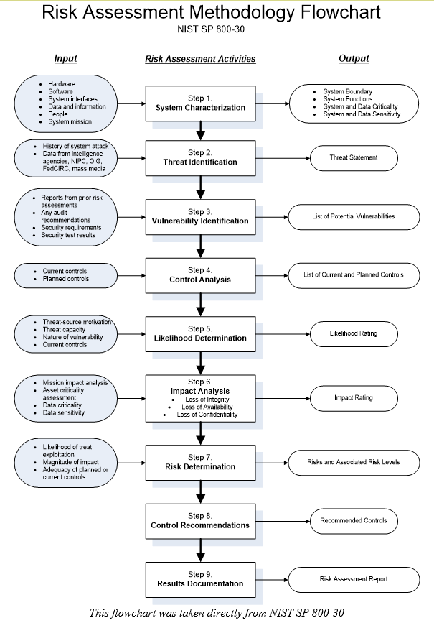
Slide headline
Risk Mitigation – Risk Assessment
© 2016 Galen Healthcare Solutions
Notes:
http://www.hhs.gov/sites/default/files/ocr/privacy/hipaa/administrative/securityrule/rafinalguidancepdf.pdf, http://hipaacow.org/resources/hipaa-cow-documents/risk-toolkit/

Slide 27
Slide headline
Risk Mitigation – Risk Assessment
Assessment drives changes in:
  Employee screening policies
  Physical security measures
  Backup procedures
  Application of encryption
  Authentication & authorization procedures
  Business associate assessments
  Etc.
© 2016 Galen Healthcare Solutions
Notes:
http://www.hhs.gov/sites/default/files/ocr/privacy/hipaa/administrative/securityrule/rafinalguidancepdf.pdf

Slide 28
Slide headline
Risk Mitigation – Employee Training
Bi-Yearly
Written policy acknowledgements
Privacy training
  Ideally tailored to specific job roles
  Stress implications of violation
Violation reporting policies
Social engineering / general security
© 2016 Galen Healthcare Solutions

Slide 29
Slide headline
Risk Mitigation – BA / Vendors
Demand and review all policy documents
Keep up-to-date BAAs in addition to MSAs and other contracts
Pay special attention to any that host or transmit PHI outside of environments in your direct control
Should be a significant element of risk assessment
© 2016 Galen Healthcare Solutions

Slide 30

Slide headline
Penalty Mitigation
Documentation
Documentation
Documentation
© 2016 Galen Healthcare Solutions

Slide 31

Slide headline
The Cloud!
Providers starting to support healthcare scenarios
  Microsoft Azure
  Amazon AWS
  Boutique Providers / Aggregators
Must offer BAAs
Compliance depends on usage
Are they safe?
© 2016 Galen Healthcare Solutions
Notes:
https://aws.amazon.com/compliance/, https://azure.microsoft.com/en-us/support/trust-center/

Slide 32
Slide headline
The Cloud!
Why are they more secure?
  Economies of scale
    Azure by the numbers
      $10+ billion invested
      $1.5+ billion/year revenue
      6+ million requests per second
      2+ million databases
      500,000+ websites
      30+ trillion stored objects
  This is their primary business
© 2016 Galen Healthcare Solutions

Slide 33
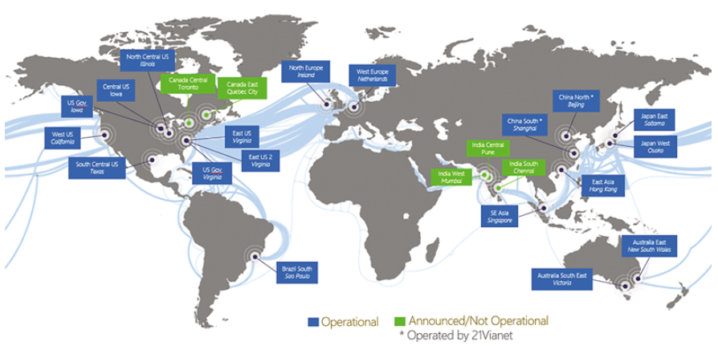
Slide headline
The Cloud!
© 2016 Galen Healthcare Solutions
Notes:
https://msdn.microsoft.com/en-us/magazine/mt573712.aspx

Slide 34
Slide headline
The Cloud!
Why should you still be cautious?
  Big target / greater reward for hackers
  Easy to use in a non-compliant way
    Many vendors likely hope you won’t ask
  Demand transparency
© 2016 Galen Healthcare Solutions

Slide 35
Slide headline
Software Vendor Selection
Software Development Lifecycle
  Process
  Security reviews & analysis
  Testing process
    Manual testing
    Code coverage
  Automation
  Pipeline Access control
© 2016 Galen Healthcare Solutions
Notes:
https://www.microsoft.com/en-us/sdl/default.aspx

Slide 36
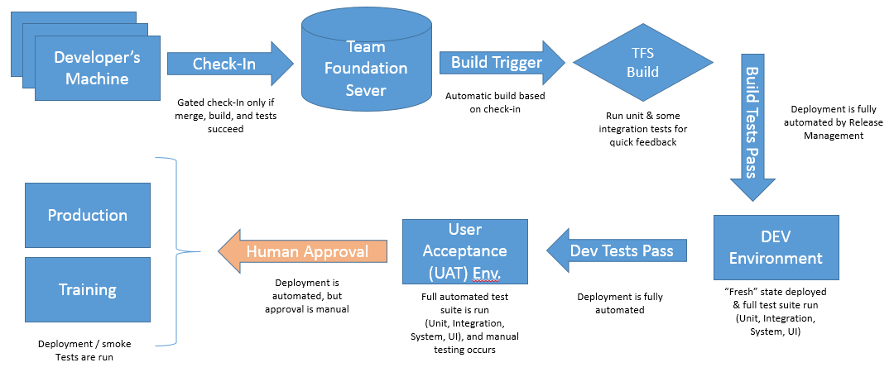
Slide headline
Software Development Lifecycle
© 2016 Galen Healthcare Solutions

Slide 37
Slide headline
Resources
  Legislation / HSS / ORC
    http://www.hhs.gov/hipaa/for-professionals/privacy/laws-regulations/index.html
    http://www.hhs.gov/sites/default/files/ocr/privacy/hipaa/administrative/securityrule/rafinalguidancepdf.pdf
    https://ocrportal.hhs.gov/ocr/breach/wizard_breach.jsf
    https://ocrportal.hhs.gov/ocr/breach/breach_report.jsf
    https://www.federalregister.gov/articles/2013/01/25/2013-01073/modifications-to-the-hipaa-privacy-security-enforcement-and-breach-notification-rules-under-the#h-95
    http://conference.himss.org/HIMSS13/pdfs/7.pdf
    http://www.poynerspruill.com/publications/Pages/SummaryofNewHIPAARules.aspx
    http://wedi.org/forms/uploadFiles/35FE700000100.filename.7.26_Combined.pdf
    https://www.truevault.com/blog/what-is-the-penalty-for-a-hipaa-violation.html
    http://hipaacow.org/resources/hipaa-cow-documents/risk-toolkit/
  IT
    https://technet.microsoft.com/en-us/library/bb735870.aspx
    http://www.gfi.com/blog/the-ultimate-network-security-checklist/
    https://aws.amazon.com/compliance/
    https://azure.microsoft.com/en-us/support/trust-center/
© 2016 Galen Healthcare Solutions

Slide 38
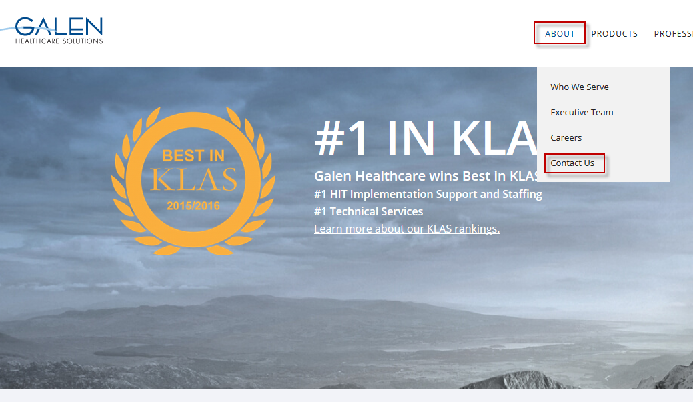
Thank you for joining us today.
To access the slides from today’s presentation, please visit:
http://wiki.galenhealthcare.com/Category:Webcasts
For additional assistance or to request information about our many services and products, please contact us through our website:
www.galenhealthcare.com

