Slide 1



MEDITECH MPM 101
July 24, 2015
Notes:
First comment prior to starting. “ Good afternoon everyone. Thanks for joining us for our webcast today, Meditech MPM 101. We still have a few minutes before we get started. We will be as prompt as possible
We do still have some folks dialing in, so we will let them get finished up and get settled and we will get started shortly
Hello. Welcome and good afternoon. Thank you for joining us for Galen Healthcare Solutions Webcast, Meditech MPM 101.

Slide 2
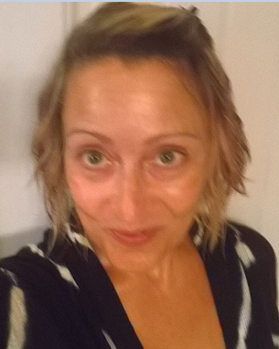
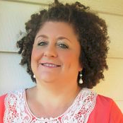
Slide headline
Solving for Today. Preparing for Tomorrow.
Today’s Presenters
*Sue D’Agostino, RN
Sr. Clinical Consultant with Galen Healthcare Solutions
    Over 20 years in Healthcare including 9 years EHR experience
    Galen TW EHR Certified, Advanced Certified-V11 Note/Orders and Results/Charge/MU 2
    Clinical Consultant, Business/System Analyst
*Kim Baxter
Sr. Consultant with Galen Healthcare Solutions
    Over 20 years in Healthcare with extensive
    knowledge of business office workflows and
    the interfacing and dependence of each
    Galen TW EHR Certified, Advance Certified-V11Note
    Business/System Analyst
Confidential © 2014 Galen Healthcare Solutions
Notes:
My name is Sue D’Agostino, I am a registered nurse and Sr Clinical Consultant, I have been with Galen for about 4 years.
My colleague, Kim Baxter, is also a Sr Consultant with Galen Healthcare Solutions. Kim has been with Galen for 5 yrs. We have some really great content for you today that we hope will give you a clearer concept of MEDITECH MPM Clinical and nonclinical workflows as well as some MEDITECH/MPM background.

Slide 3
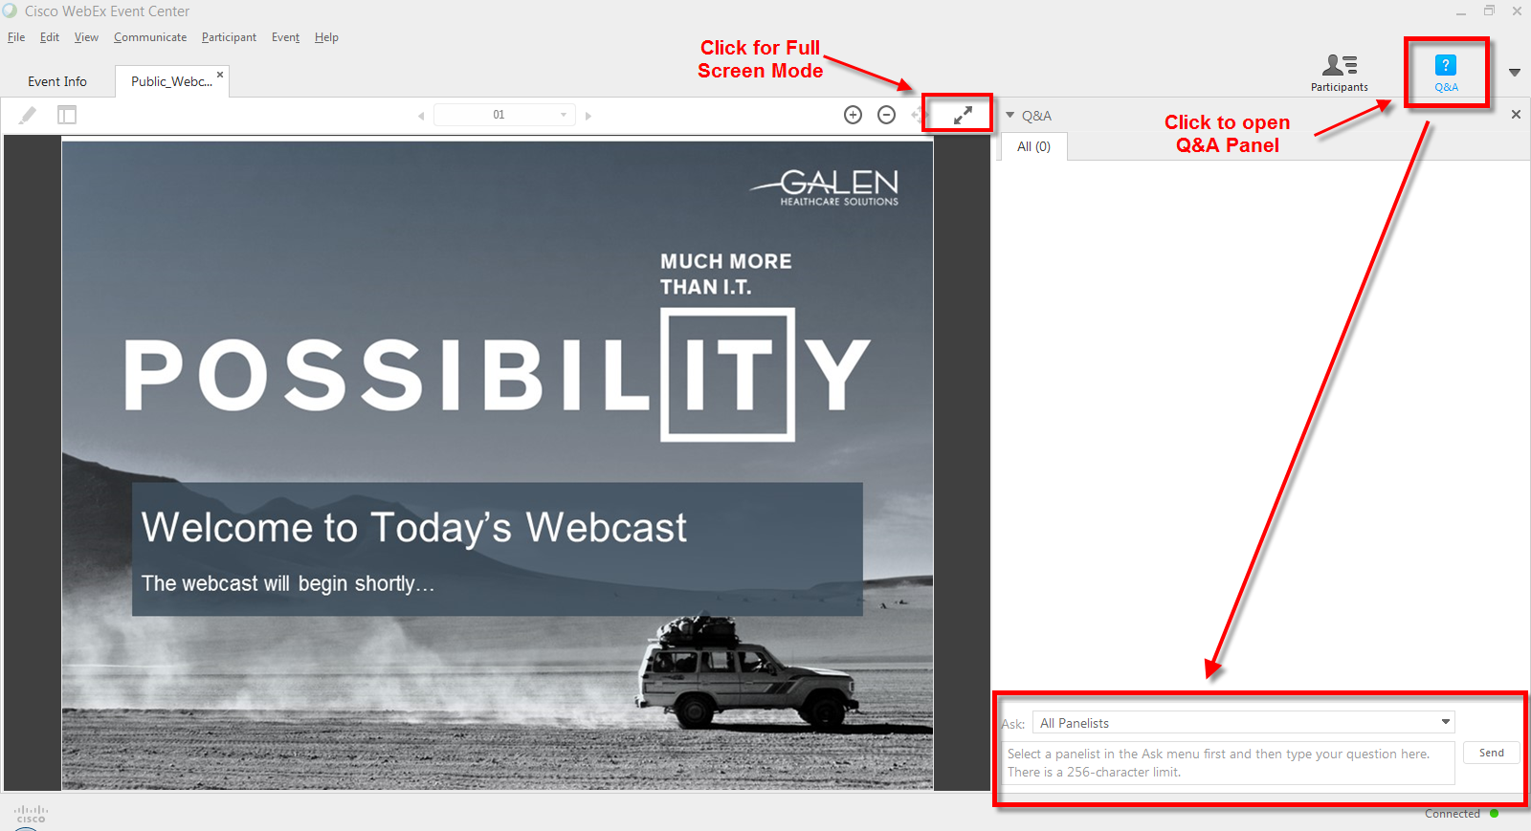
Slide headline
Solving for Today. Preparing for Tomorrow.
Your phone has been automatically muted. Please use the Q&A panel to ask questions during the presentation!
Notes:
Just a few housekeeping items to get out of the way before we get started. Your phone has been muted, we encourage you to please use the Q& A panel to ask questions during the presentation. We will try and answer a few questions at the end of todays webcast, however, all questions and answers, along with the slides from todays presentation will be posted on the Galen Wiki within a few days. Also, please note that you can click the arrows icon to view the presentation in full screen mode.
So with that out of the way, let’s get started.

Slide 4
Agenda for Today
Slide headline
Solving for Today. Preparing for Tomorrow.
Brief introduction to MEDITECH and MPM
Interoperability between MPM and the inpatient MEDITECH EHR
Patient Visit from Check In to Check Out
Confidential © 2014 Galen Healthcare Solutions
Notes:
On our agenda for today:
We will go over a brief introduction to MEDITECH and MPM
Discuss the bonus of interoperability between the inpatient EHR and the ambulatory outpatient MPM EHR
We’ll also review the patient visit from Check in to Check Out including some tips and best practice along the way

Slide 5



Slide headline
Solving for Today. Preparing for Tomorrow.
AKA Medical Information Technology, Inc.
founded in 1969, based in Massachusetts
most customers in US, Canada and UK
Health Information Management
Revenue Cycle
Emergency Department Management
Data Repository Scanning and Archiving
Home Health
Long Term Care Solutions
http://www.museweb.org/
Confidential © 2014 Galen Healthcare Solutions
Notes:
A little background information on MEDITECH and MPM for those of you who are either new to MEDITECH or just may not have had this information
Also know as- Medical Information Technology Inc. MEDITECH was founded in 1969. It is a Massachusetts based medical software and service company. The organizations they serve include Physician Practices, Ambulatory Care Centers, Acute Care Hospitals. Long Term Care Facilities and Home Health. MEDITECH customers are located in several different countries with most customers located in the United States, Canada, and the United Kingdom.
As you can imagine MEDITECH offers many types of software including:
Health Information Management, Revenue Cycle,, Emergency Department Management, Cost Accounting, Data Repository, General Accounting, Human Resource Planning, Supply Chain Management, Operating Room Management, Patient Discharge Instructions, Long Term Care Solutions, Behavioral Health Solutions, and Home Health Solutions. AND THE LIST GOES ON.
In 2000 and 2001 MEDITECH invested in LSS Data Systems and in February 2011, acquired complete ownership. In 2000, both the practice management product and ambulatory EMR were incorporated into a suite of applications for physician practices called the Medical and Practice Management (MPM) Suite.^{[5]} In addition to LSS's physician billing, practice management application (PBR) and Electronic Ambulatory Record (EAR), the suite meshes together applications jointly developed with MEDITECH, including scheduling, order management, scanning and a web-based patient portal.
Today we will be focusing mainly on MPM.
Similar to other EHRS, Meditech also has a user group… MUSE (Medical Users Software Exchange) is the largest independent MEDITECH user group that provides networking, education and training for MEDITECH organizations. The MUSE website can be found at www.museweb.org

Slide 6
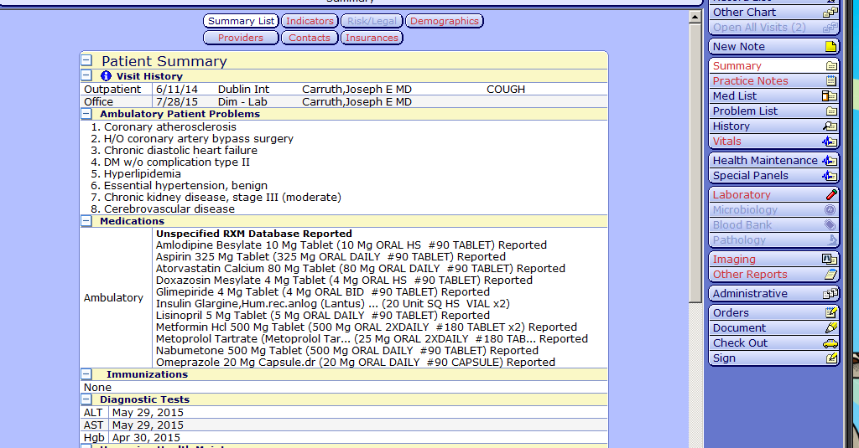
Slide headline
Solving for Today. Preparing for Tomorrow.
MEDITECH MPM
Cal Health Services
Smith,Thomas F MD
Cal Health Services
Smith,Thomas F MD
Confidential © 2014 Galen Healthcare Solutions
Notes:
A brief review on the interoperability between the MEDITECH outpatient and inpatient EHR. To access the inpatient record from the outpatient chart, the user needs to select the “Other Chart” button from within the Table of Contents. This will open up the inpatient chart. One thing to remember, a user does need to be granted access to the inpatient record to use this functionality.

Slide 7
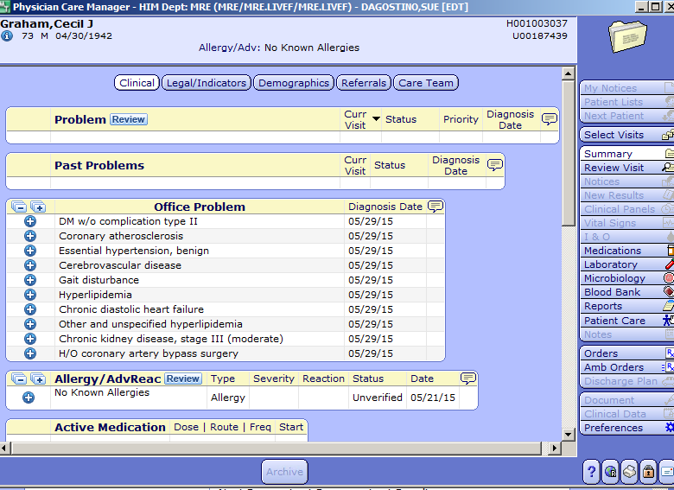
Slide headline
Solving for Today. Preparing for Tomorrow.
MEDITECH INPATIENT
Confidential © 2014 Galen Healthcare Solutions
Notes:
Depending on what type of inpatient encounters have occurred, we can review all available patient information including Orders, Results, Documentation, Clinical data, Vital Signs and even that patients Input and Output if documented. This functionality provides physicians with the ability to easily obtain patient information without having to go in and out of separate systems or even more time consuming, have support staff call the hospital to have the information faxed to the office.
Next we will go thru an outpatient office encounter. We will start at the very beginning with the scheduling of appointments and navigating the scheduler’s desktop, heading into check in, going thru intake and the physician exam, and finishing with check out. I’m going to hand things over to Kim to begin our process.

Slide 8
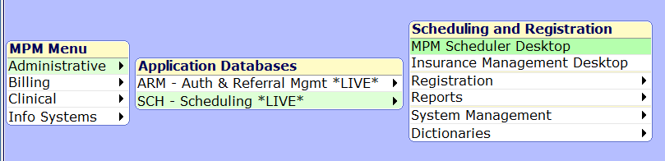
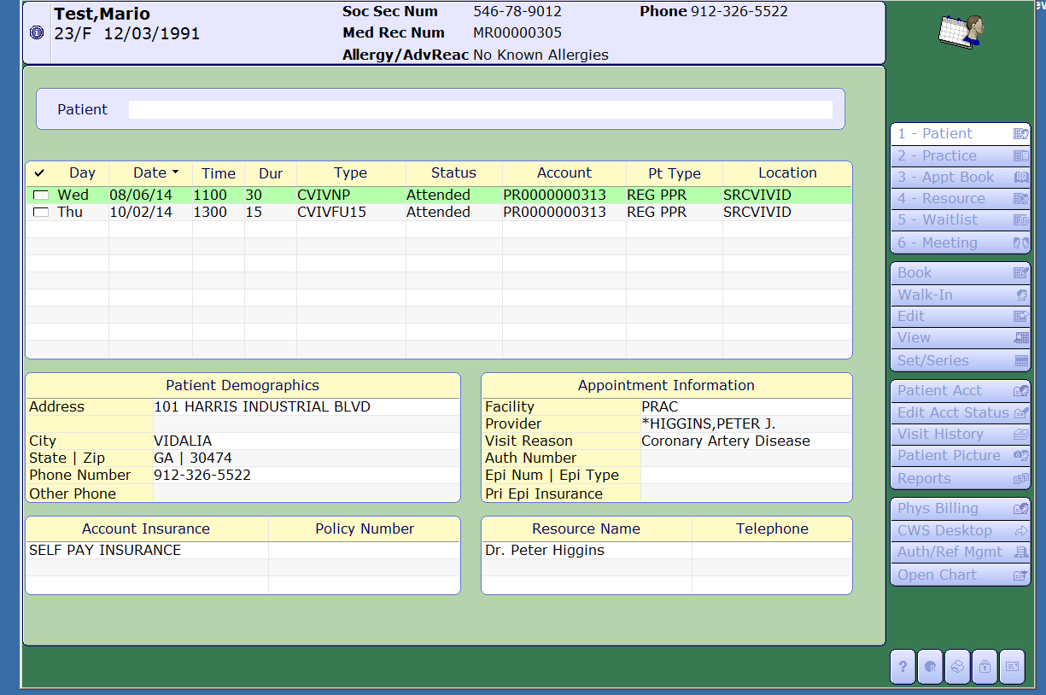
Slide headline
Solving for Today. Preparing for Tomorrow.
Check In and Intake process
Confidential © 2014 Galen Healthcare Solutions
Notes:
From the Administrative Menu, select Scheduling, MPM Scheduler Desktop.
Depending which menu option you have chosen on the right, your screen and the options on each screen will change somewhat.
On the Patient Screen as shown here, you can search for a patient, see the past and future appointments, review patient demographics, detailed appointment information for appointment highlighted, Insurance and which provider that appointment is scheduled with.
Display – allows you to change the date range and appt. status, resources, appt. type and registration status for your search.
Letters / Forms – allows you to print, spool/queue, or delete letters and forms for the selected appointment or meeting.
Encounter Form – generate an encounter form for the highlighted appointment.
Change Status – change the status of the appointment
Duplicate – Create a duplicate of the highlighted appointment or meeting. Keeps the same appointment type, visit reason and resource.
Follow Up – Create a follow up appointment for the highlighted appointment. You can change the appointment type.
Times – Record times for the appointment, including when the patient arrives and departs.
Alerts – Enter/Edit patient specific alerts.
Health Maint – View the selected patient’s Health Maintenance and Disease Management Record
Future Appts – View the selected patient’s future appointments. Even ordered procedures that have been placed via Ambulatory Order Management.
Rvw Elig - View the results of insurance and rx eligibility previously ran on patient.

Slide 9
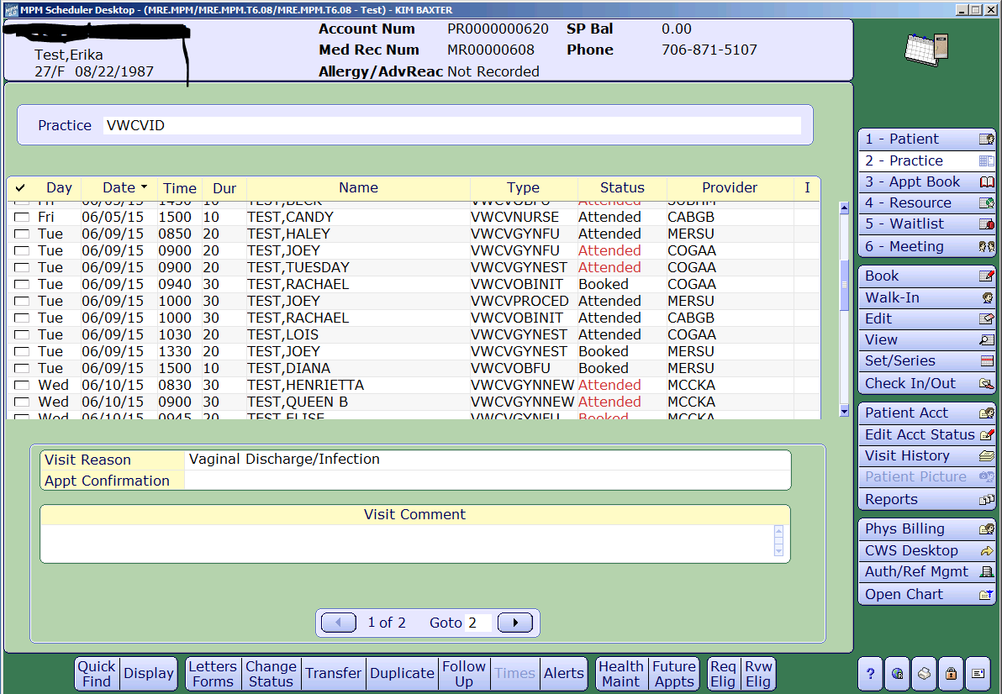
Slide headline
Solving for Today. Preparing for Tomorrow.
Confidential © 2014 Galen Healthcare Solutions
Notes:
The practice view – Shows you all appointments schedule for a particular practice. You have the option to include or exclude no-shows, canceled, pending, booked, or attended appointments. When an appointment is highlighted the Visit Reason, Appt Confirmation, and any visit comments will show. (Click)
The footer buttons are pretty similar to the previous screen with exception of the Quick Find. This lets you pinpoint a patient on the days schedule without scrolling through all appointments. Come in handy for large sites.
Again, depending on your version and build your options might vary slightly.

Slide 10
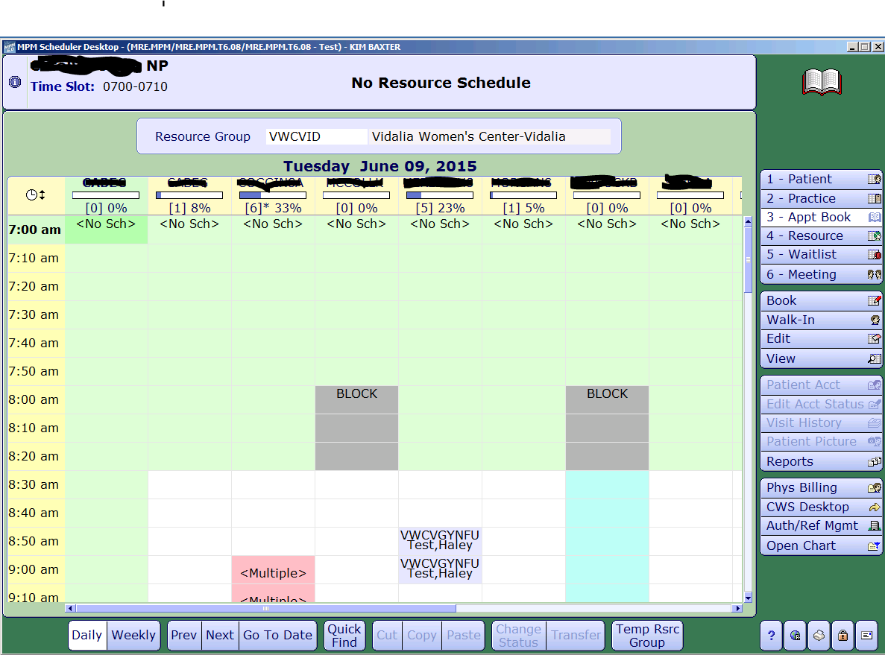
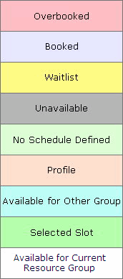
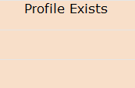
Slide headline
Solving for Today. Preparing for Tomorrow.
Confidential © 2014 Galen Healthcare Solutions
Notes:
This view is for Resource Group – Explain what a resource group is and what the top row is. (click)
Footer buttons are different on this screen.
Daily or weekly format.
Previous/next day or week, go to a specific date.
Do a quick find to specific search for a patient within the parameters you have in your view.
cut, copy and paste options allows you to move an appointment from one time slot to another. However, I will caution you about moving it to another providers schedule. Example : move from a provider to a Mid level schedule to help cover overflow. When the mid level goes to do their note, the note might still show as the note owner as the original provider. This will cause issues on signing off the note.
Change status
Transfer option. By using the Transfer footer button you can move the appointment from one resource to the other, making the new resource the encounter owner.
Temporary Resource Group – By default settings, you are assigned a resource group. By using this footer button you will be able to modify that group in the appointment book view mode only. The next time you go out of this view and back in you default group will then reappear.
Color Code –
Pink – Overbooked
Light Grey – Booked
Yellow – Waitlist
Dark Grey – Unavailable
Light Green – No schedule defined
Light Pink – Profile
Aqua – Available for other Group (such as a satellite office)
Green – Selected Slot
White – Available for Current Resource Group

Slide 11
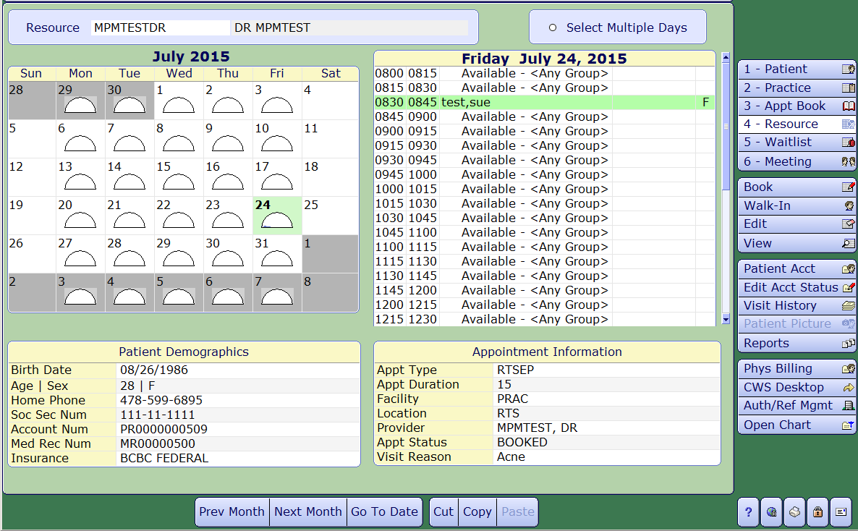
Slide headline
Solving for Today. Preparing for Tomorrow.
Confidential © 2014 Galen Healthcare Solutions
Notes:
This view is from the Resource View and it gives a lot of information but you cannot change the patient status from here so we are not going to spend time on all the options.

Slide 12
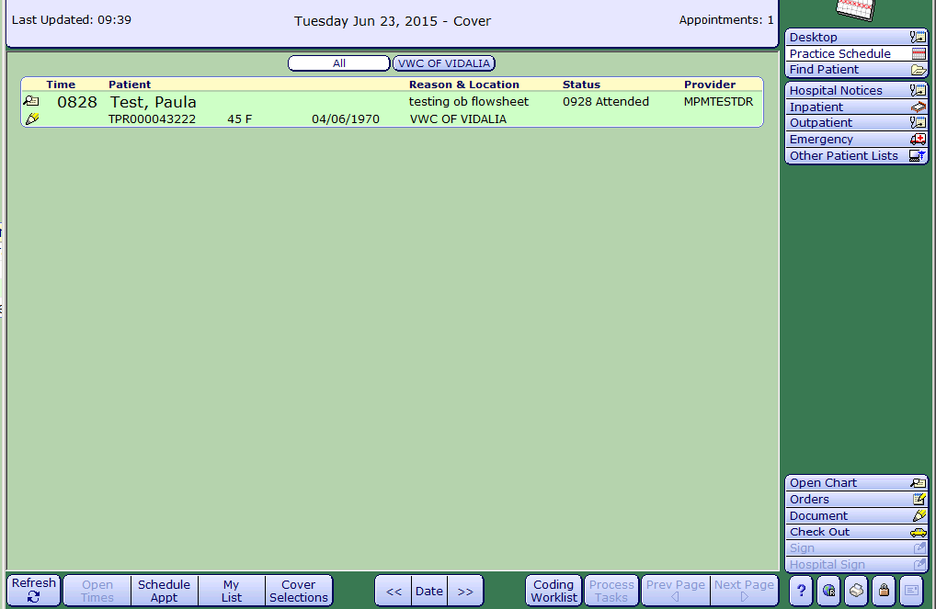
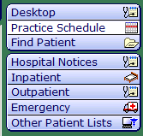
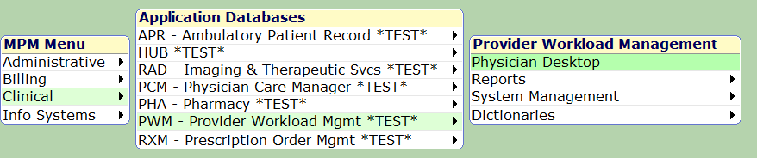

Slide headline
Solving for Today. Preparing for Tomorrow.
Confidential © 2014 Galen Healthcare Solutions
Notes:
From the Clinical Menu, there are a couple of areas you can schedule an appt. from. One is the Practice Schedule Window. At the bottom of the screen you will see the option to schedule an appointment and even view open times. When you click on these options, you will be launched into the Scheduler Desktop.

Slide 13
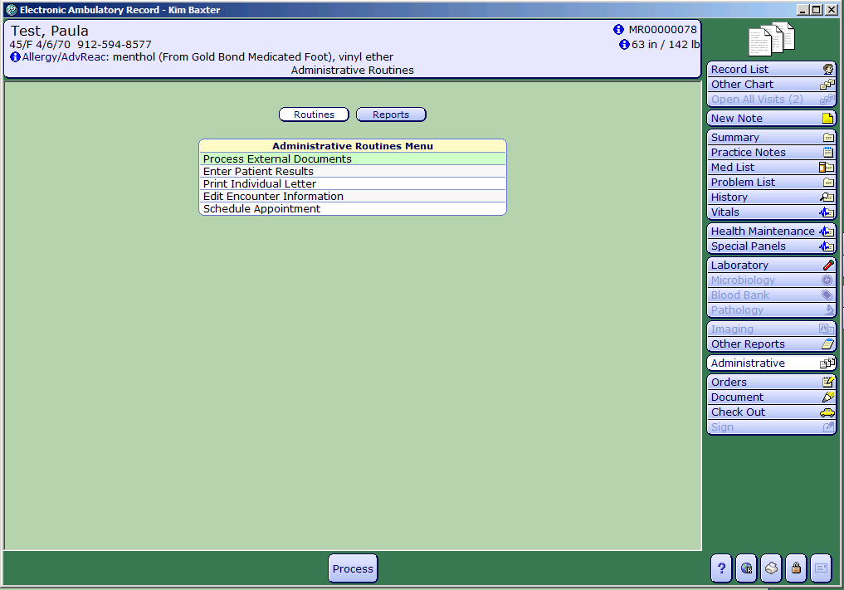

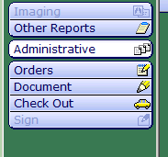
Slide headline
Solving for Today. Preparing for Tomorrow.
Confidential © 2014 Galen Healthcare Solutions
Notes:
The other area is the from within the patient chart. On the right you will see an administrative button. When you select Administrative you get several options of Routine and Report. From the routines area, one of your options will be to schedule appointment. When selected you will again be launched into the Scheduler Desktop.

Slide 14
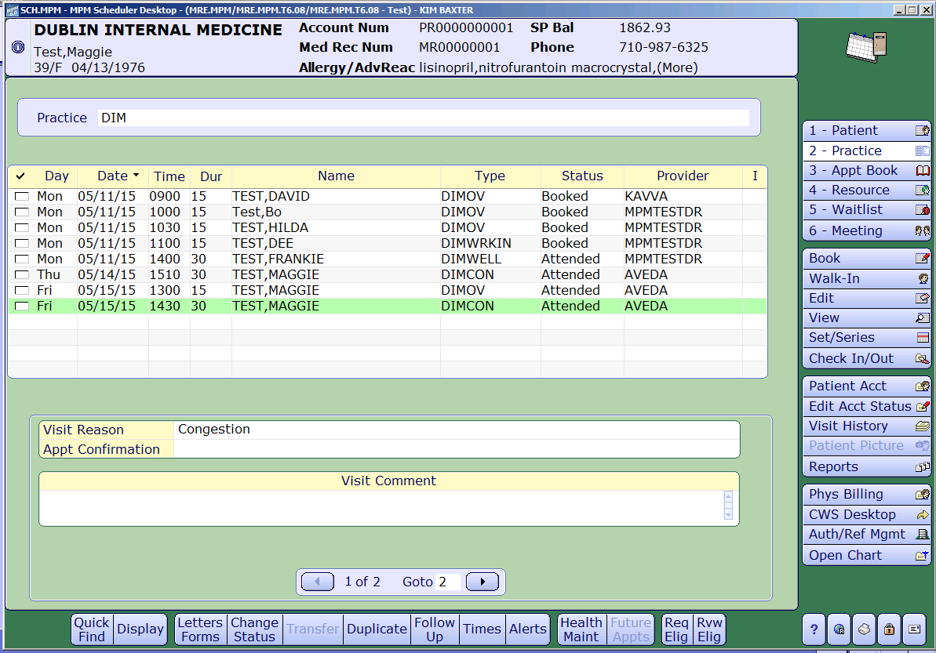
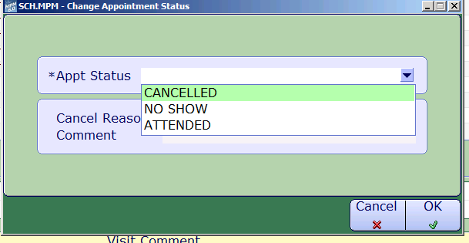
Slide headline
Solving for Today. Preparing for Tomorrow.
Check In and Intake process
Confidential © 2014 Galen Healthcare Solutions
Notes:
From any of these windows – you can change the status of the appointment by highlighting the selecting appointment and chose the Change Status footer button. You are then given the options set as appropriate for this stage. Example above is Canceled, No Show or attended.

Slide 15
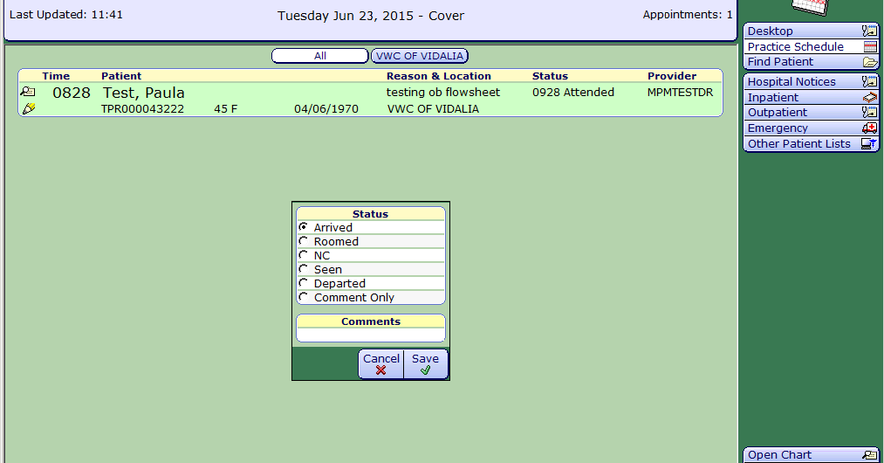
Slide headline
Solving for Today. Preparing for Tomorrow.
Check In and Intake process
Confidential © 2014 Galen Healthcare Solutions
Notes:
To change the status of the appointment from the Clinical Side – Practice Schedule, Double Click on the status column for the highlighted patient.
Arrived – what status the patient is given when checked in by the Reception desk.
Roomed – patient has been moved from the waiting area to a room
NC – Nurse Cleared – nurse has finished intake and patient is ready for provider
Seen – Provider has finished visit and patient is ready to be discharged
Departed – Patient has checked out and has left office.
Comment only – If the status of the patient has changed but the patient has changed rooms or is in lab waiting, etc.
Comments – good place to put room number

Slide 16
Slide headline
Solving for Today. Preparing for Tomorrow.
Confidential © 2014 Galen Healthcare Solutions
Notes:
To change the status of the appointment from the Clinical Side – Practice Schedule, Double Click on the status column for the highlighted patient.
Arrived – what status the patient is given when checked in by the Reception desk.
Roomed – patient has been moved from the waiting area to a room
NC – Nurse Cleared – nurse has finished intake and patient is ready for provider
Seen – Provider has finished visit and patient is ready to be discharged
Departed – Patient has checked out and has left office.
Comment only – If the status of the patient has changed but the patient has changed rooms or is in lab waiting, etc.
Comments – good place to put room number

Slide 17

Slide headline
Solving for Today. Preparing for Tomorrow.
Confidential © 2014 Galen Healthcare Solutions
Notes:
Now we will show where the nurse takes over. The nurse will navigate to the Physician Desktop, Click on Practice schedule and select the Pencil to pull in the note template. As you see note templates can be marked as favorites to ease in selection of the most commonly used per user. This can also be done from the back end for all users at a site before go live.

Slide 18
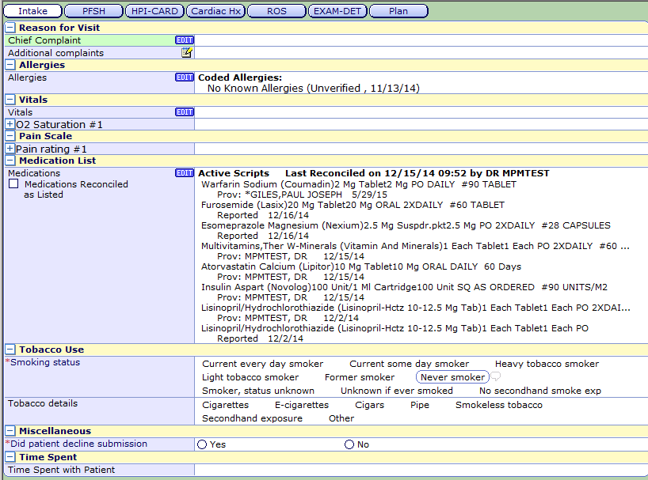
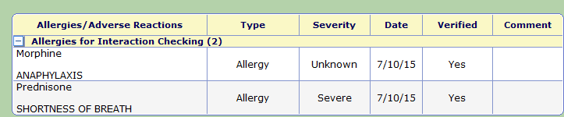
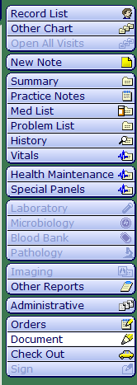
Slide headline
Solving for Today. Preparing for Tomorrow.
Confidential © 2014 Galen Healthcare Solutions
Notes:
The nurse will then click on the Intake “Bubble” to start the visit.
As you can see in this template the CC is a text field. However, depending on your practice you might want a defined list with an option to add text.
-Allergies – when you click edit this will take you to a separate window where you can add, update or remove an allergy and assign it an Adverse Reaction, Type and Severity.
-Vitals – Edit will open the vitals panel just the same as if clicking on the chart section on the right of the documentation screen.
-Medications – at a glance view of meds and if no changes easy reconciliation check box with this space.
Tobacco Use Questions
Other misc that your facility or provider desires to be answered upon intake.

Slide 19
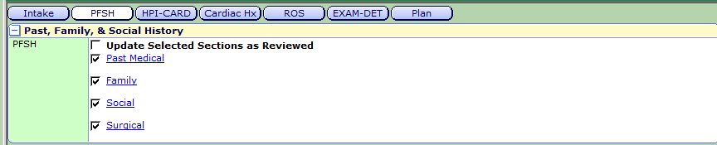
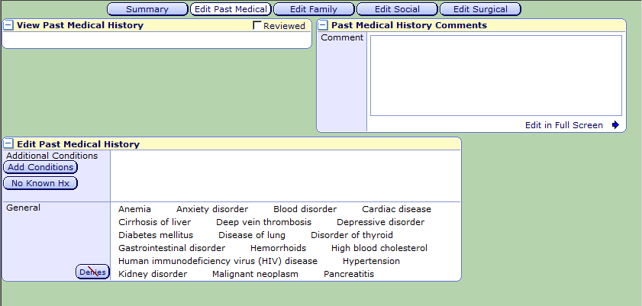

Slide headline
Solving for Today. Preparing for Tomorrow.
Confidential © 2014 Galen Healthcare Solutions
Notes:
The PFSH captures the Medical History on the patient. By clicking on the blue hyperlinks you will open a secondary window that allows for each section to be updated. Within each section there is a check box where you can check that the section was reviewed. Once all updates are complete, then the UPDATE SELECTED SECTIONS AS REVIEWED should be checked.
Once the nurse has reviewed all history and completed their intake and other sections they are responsible for, they will save as In process and turn the patient over to the provider.
Now we will turn things over to Sue..

Slide 20
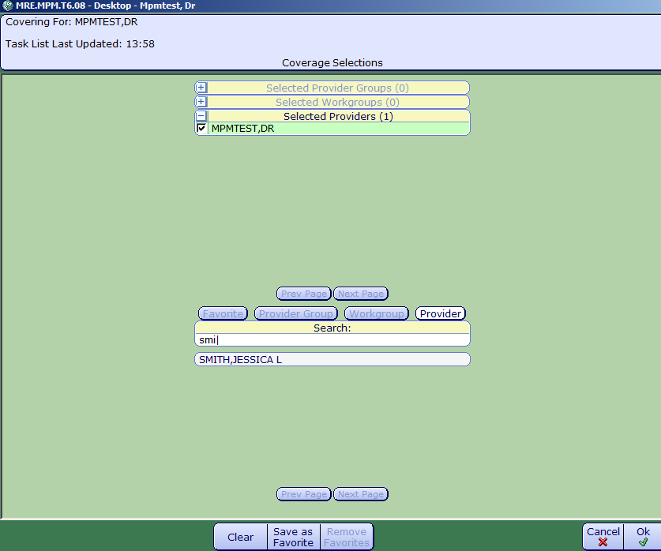
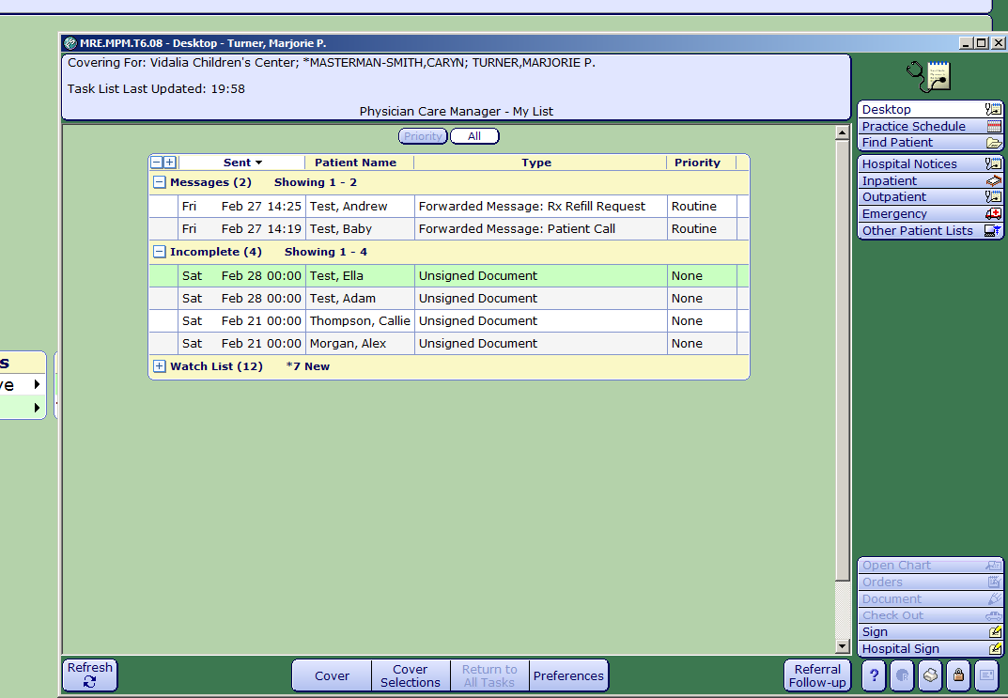
Slide headline
Solving for Today. Preparing for Tomorrow.
Desktop
Confidential © 2014 Galen Healthcare Solutions
Notes:
Thanks Kim. Before we begin the physician patient visit workflow. I just wanted to take a moment to discus the physician Desktop and then we’ll slide right into Physician Workflow from there
The Desktop is the first thing a provider sees upon logging into MPM. It is their task list. Any patient messages, results, incomplete documents, prescription renewals, and so on will show here.
Watchlist- support staff tasks
Best practice is to monitor throughout the day, especially first thing and at the end of the day.
Other actions that are performed from the desktop include: Preferences, Return to All Tasks, Cover Selections and Cover. I’ll briefly go over Preferences and Return to All tasks as they are not as routinely used as cover and cover selections.
Preferences: Select this button to access the PWM(Provider Workload Management) Preferences Dictionary. From here the user can edit their desktop preferences.
Return to All tasks: When the user is on a Find Patient list of Individual patient tasks, the Return to All tasks button will return the user to desktop tasks . Otherwise this button is unavailable.
When the provider wishes to see the tasks of the user they are covering, they would click the Cover button..
Cover selections allows the provider to select the provider they wish to ‘cover’ or monitor tasks for. Clicking the Cover Selections button will open the coverage selection window so that the provider can select their coverage user or group . As you can see, The provider has the ability to select provider groups, workgroups or individual Providers that they wish to cover. Typing a few letters of the providers last name or group into the search bar brings up the name, the user clicks on the correct name and then clicks OK.

Slide 21
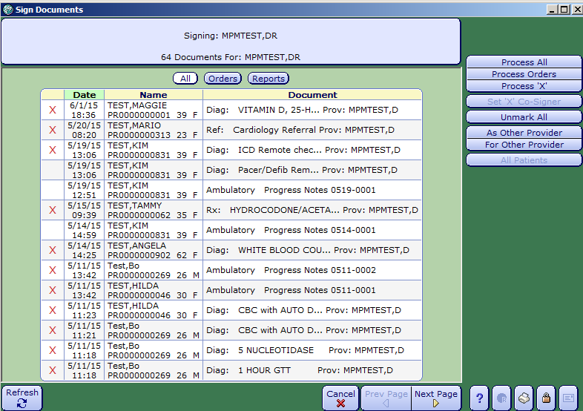
Slide headline
Solving for Today. Preparing for Tomorrow.
Confidential © 2014 Galen Healthcare Solutions
Notes:
In addition to the ‘tasks’ on the Desktop, another tasking workflow is signing off on orders. Many organizations have their systems set so that any orders entered by support staff need to be signed off by the physician. Clicking on the Sign button will allow the provider to sign orders and reports or notes that are in a status of unsigned.
The Sign Documents Window will pop up. The provider can filter by orders, reports (notes) or all. They can also filter by name ,date or Document.
For Process X the provider clicks the box next to the patient items they wish to work on by clicking in the first column. This process will put a red x next to each item selected. Then the provider would click the process x button to begin signing.. A couple of examples of why this workflow might be used are if the provider only has time to go thru only a few items or if they wanted to approve one patients’ orders.
The Process All Button allows the provider to process all items that are in need of a signature. Process Orders will process Orders only. Again, using Process X would allow us to sign off on only the items we has selected.

Slide 22
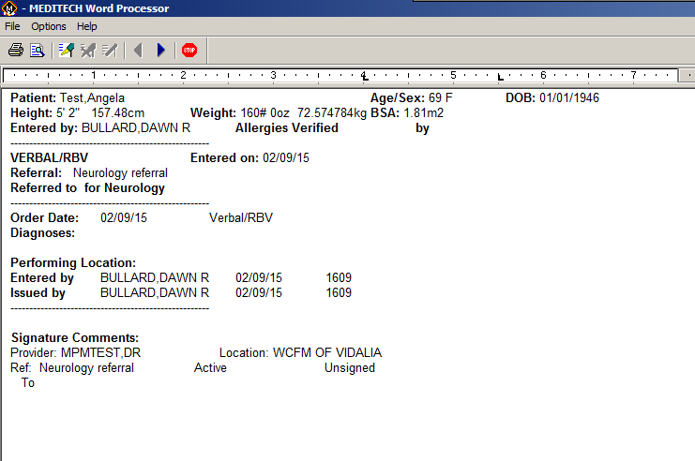
Slide headline
Solving for Today. Preparing for Tomorrow.
Test, Sandy L
Test, Sandy L
Test, Sandy L
Cal Health
Confidential © 2014 Galen Healthcare Solutions
Notes:
This is an example of a referral order. To sign, the provider will click on the Pen icon. This will bring them to the next order that needs signature. If they needed to stop the process at any time, they can click on the Stop Sign icon. Once they have either finished clicking the pen for all orders, or clicked the Stop button, the system will alert them to how many items are queued for signature.

Slide 23
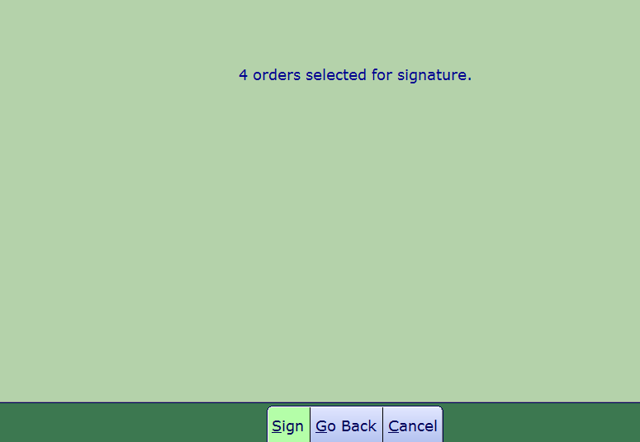
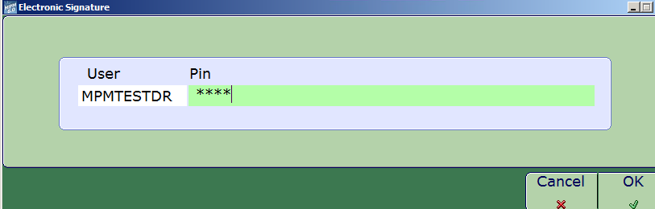
Slide headline
Solving for Today. Preparing for Tomorrow.
Confidential © 2014 Galen Healthcare Solutions
Notes:
They can then click the Sign button and the electronic signature window will open. The provider enters their pin, clicks OK and will be brought back to the desktop.

Slide 24
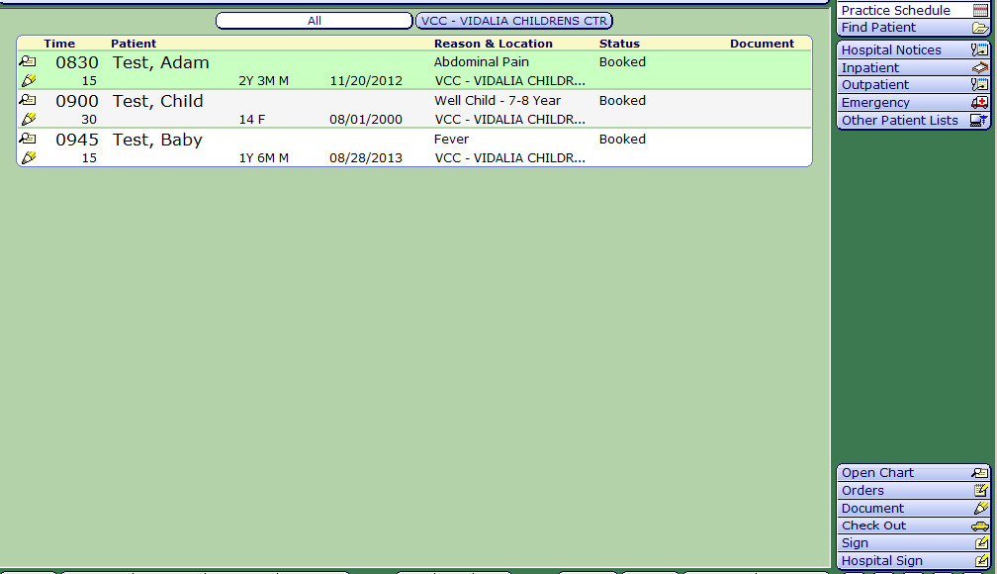
Slide headline
Solving for Today. Preparing for Tomorrow.
Cal Health
Cal Health
Cal Health
Cal Health
Confidential © 2014 Galen Healthcare Solutions
Notes:
And we are now back at our schedule to begin our patient visit workflow. From here, the physician will click on the patient to bring into context. Once the patient is in context, the patient name and information for visit is highlighted a different shade than the other patient encounters, and the Chart buttons will be available to select. . To open the chart, we can either select the magnifying glass or click on the Open chart button which is the first button in that lower corner.
To go straight into the note that our nurse has opened, we will click on the pencil icon.

Slide 25
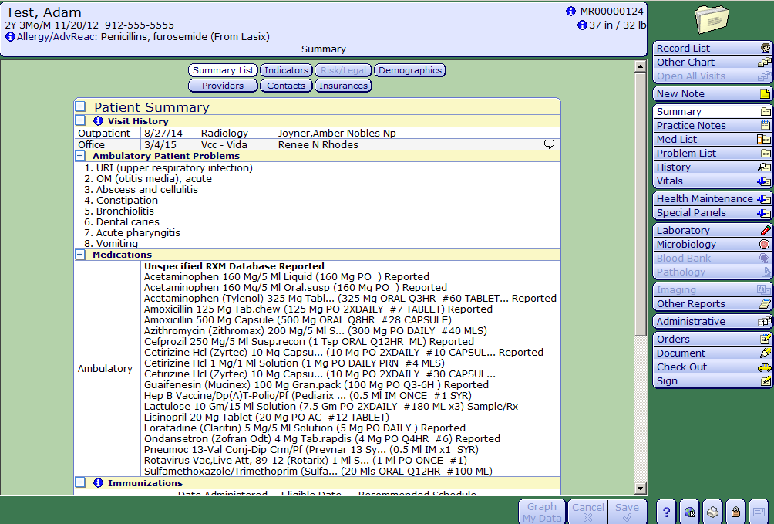
Slide headline
Solving for Today. Preparing for Tomorrow.
Confidential © 2014 Galen Healthcare Solutions
Notes:
If the provider wants a quick review of the patient prior to going to the note, when they open the chart they will be brought to the Patient Summary. The Patient Summary is like a ‘snapshot’ of all patient information. In the Summary, you will find Visit History, Problems, Meds, Immunizations, Growth Charts and Health Maintenance items. To prepare for the visit, the physician can navigate thru the patient chart to review previous practice notes, labs, problems and any other relevant clinical information
To go back to our schedule, we can select Record List.
To begin our documentation, we will click on Document button

Slide 26
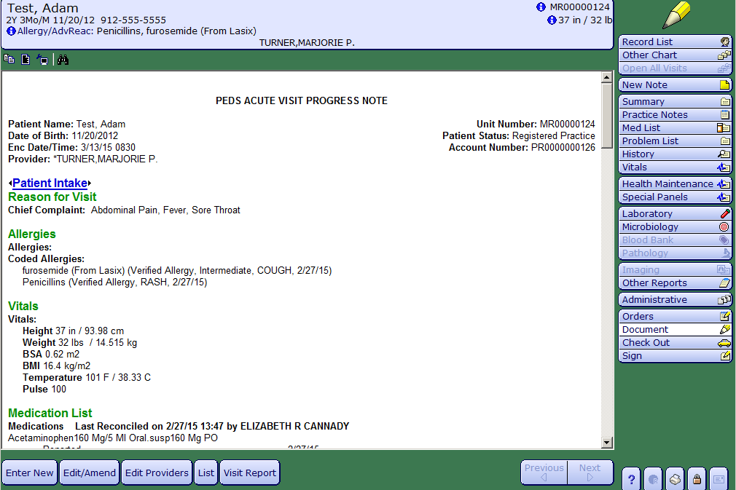
Slide headline
Solving for Today. Preparing for Tomorrow.
MPMTEST, SANDRA
Confidential © 2014 Galen Healthcare Solutions
Notes:
We are at the document that was opened by our support staff, with the necessary intake information entered. We can review the intake performed by our nurse or we can select the Edit/Amend Button to begin documenting.
We can also select a Blue Hyperlink that will bring us into that particular note section. We do have the ability to scroll thru the note in the event we just wanted to jump into a particular note section we could access by the hyperlink associated with it.
And while we are here, this format is how the actual visit note is presented within the patient chart.

Slide 27
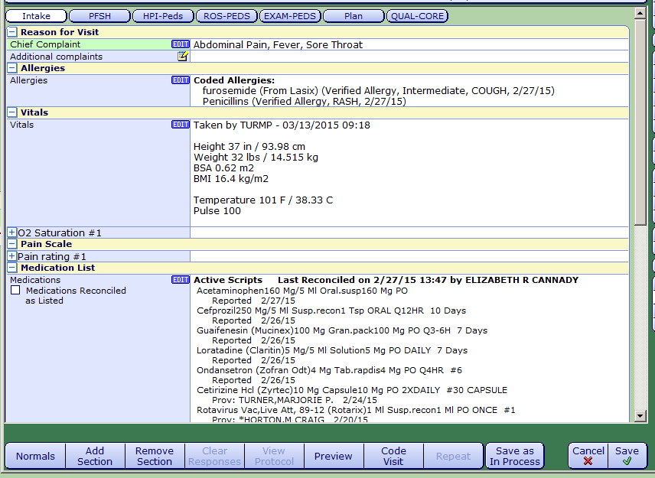

Slide headline
Solving for Today. Preparing for Tomorrow.
Confidential © 2014 Galen Healthcare Solutions
Notes:
This brings us into our template or note documentation workspace.
The Bubbles at top of Template indicate the Note Sections of the Template. (ie: HPI, ROS, PE)
The section Bubble that you are documenting will always be white
Normals- allows us to add our “Normals” to the Review of Systems and Physical Exam sections of our note template and the provider can then go back and document by exception. (an example of this: PE, Constitutional- Well developed, well nourished, in no acute distress)
We can also Add or Remove a Section. This functionality could be used if the provider wishes to use a different physical exam for example then the one that is in the template in use. They could add a new physical exam section and remove the section they did not want.
Clear Responses- pretty self explanatory, this will clear any responses documented in the section
View Protocol_ Protocols are clinical treatment plans associated with documents. In order for the View protocol footer button to be activated, the protocols must be attached to the templates via the Ambulatory MIS Physician Documentation Template dictionary.
Preview- allows the user to see what the actual visit documentation will look like in the patient chart.
Code visit- This opens the Code Visit window to allow the provider to enter in their level of care for the visit.
Repeat- If a query has been built to document multiple instances of an issue or problem, selecting the Repeat button while highlighted on that Multiple query. will automatically repeat the query in the next sequence. ( an example of use could be if the patient has two lesions, the physician wants precise documentation for both lesions and wants to differentiate between Lesion 1 and Lesion 2. They could use the repeat functionality to perform this action.)
Save as In Process will save the note as an “In Process” status. This means that the user can go back to the template and add or remove documentation if needed.
Cancel/Save Buttons. If Cancel is selected prior to the note being saved in process, the whole template will be canceled. If the template has been saved, the user enters documentation and cancels, the additional documentation will be canceled but the original documentation will stay intact. Selecting the Save button provides several options for the template. WE can save in Process or select one of the following
Draft only allows the addition of documentation. The user will be unable to remove documentation. Signed- which will sign and finalize the note template. If anything is to be added, it will become an Addendum. Cancelled, is used to totally cancel the note but can only be used and is only available if the note has not yet been signed.

Slide 28
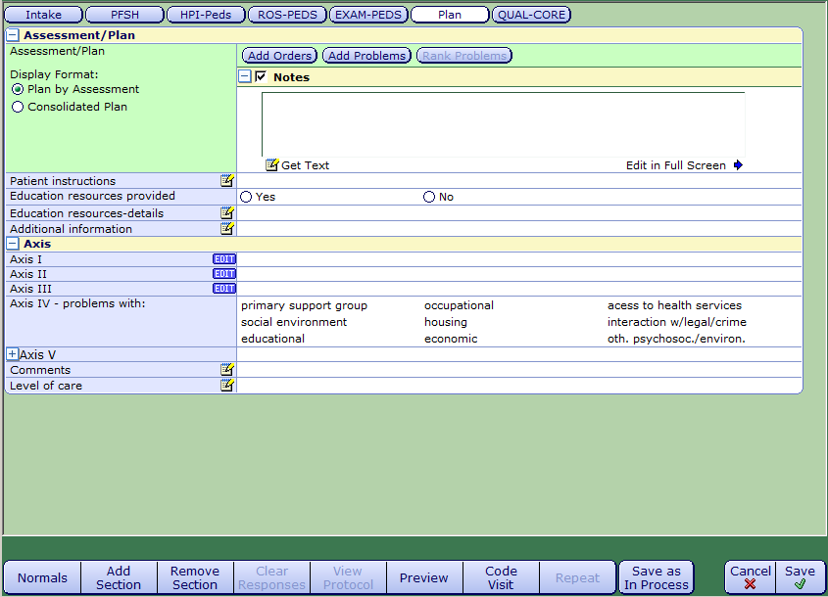
Slide headline
Solving for Today. Preparing for Tomorrow.
Confidential © 2014 Galen Healthcare Solutions
Notes:
We’ll talk a little bit about CPOE (Computerized Physician Order Entry) and how that is performed in MPM. You can access the Orders Module from the table of contents but we will be demonstrating the Orders workflow through Documentation.
Once we are in the plan section we can begin entering Orders. Best practice is to “Add Problems” prior to adding the Orders. By adding our problems first, the Ordering process will be less cumbersome.

Slide 29
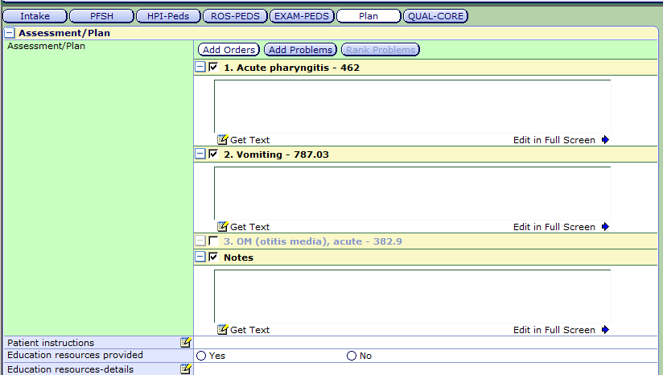
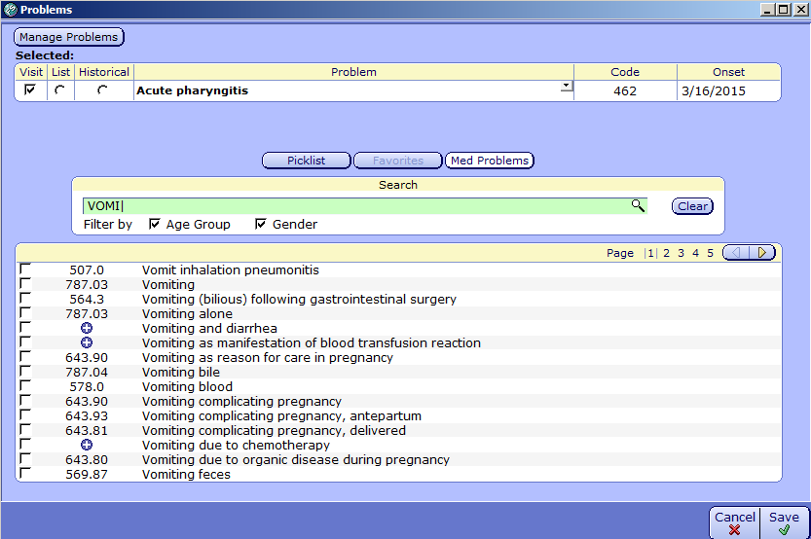
Slide headline
Solving for Today. Preparing for Tomorrow.
√
Confidential © 2014 Galen Healthcare Solutions
Notes:
Once we click the Add Problems button, the Problems window will open. Type in the search bar to find our problem, either click the magnifying glass or the “enter” key of your keyboard, and then check the box next to the appropriate diagnosis. Once all appropriate Diagnoses for the encounter have been selected, click Save. This will bring us back to our plan where we will then click the Add Orders Button.

Slide 30
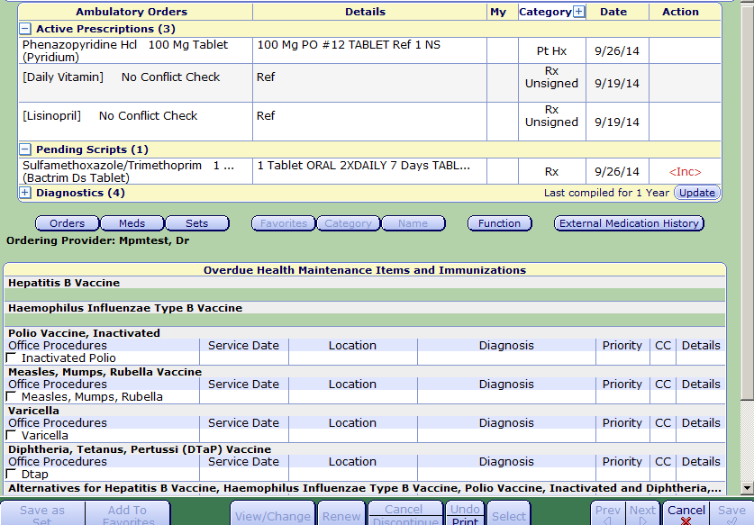
Slide headline
Solving for Today. Preparing for Tomorrow.
Confidential © 2014 Galen Healthcare Solutions
Notes:
Once we have clicked “Add Orders” , the Ambulatory Order Management Screen will open. At the top of the screen you will see any current prescription and diagnostic testing that have already been ordered for the patient. This allows the provider to easily access the patients current orders to avoid duplicate ordering. However, a patient with multiple medications could take up a great amount of ordering workspace so, best practice would be to minimize the current ambulatory orders to enable a larger workspace to enter in todays visit orders. Often, especially during the first few days of a go live, I constantly remind providers about that minimize button. When a patient has 20-30 medications, it takes up a lot of space and a lot scrolling is needed to get to where the ordering happens.
To order a diagnostic test- we’ll select the Orders Button. If we have any favorites saved, the system will default to our favorites, otherwise we can use the search by Name functionality.

Slide 31
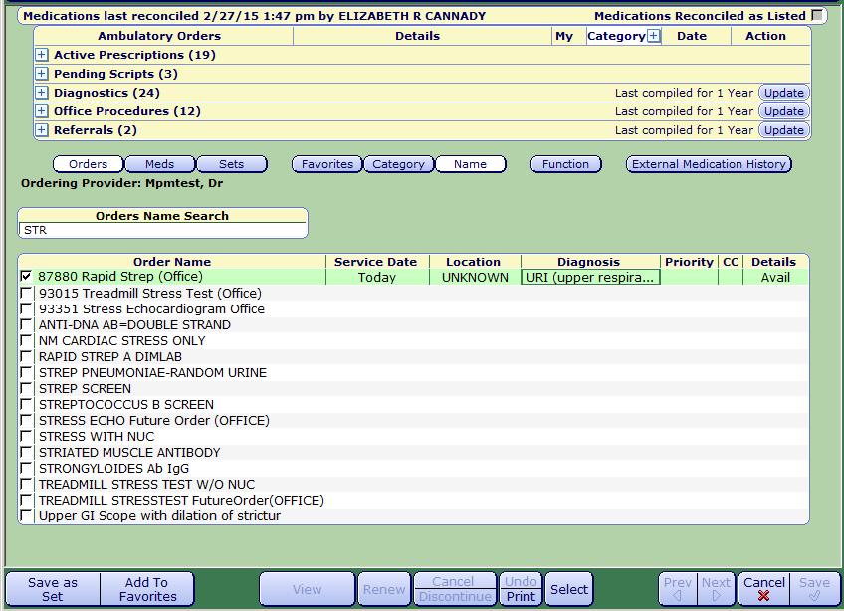
Slide headline
Solving for Today. Preparing for Tomorrow.
Susan Smith
LAB
Confidential © 2014 Galen Healthcare Solutions
Notes:
Type in a few characters to search for the order, check the box next to the correct order, enter in any required information. If this is the only item we need to order for the patient we will click the Select button and then save. However in this case we will also order a medication.

Slide 32
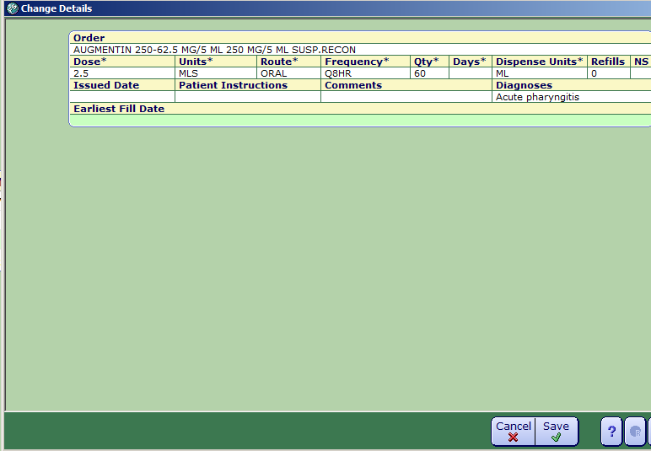
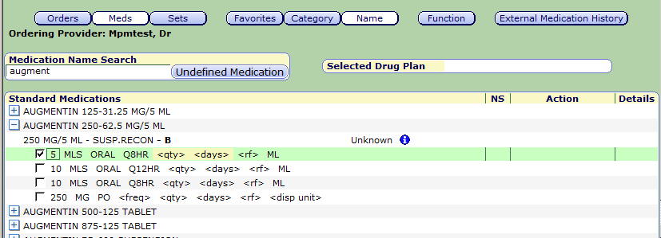
Slide headline
Solving for Today. Preparing for Tomorrow.
Confidential © 2014 Galen Healthcare Solutions
Notes:
To order a medication, click the Meds Button, and as with the orders, if there are favorites saved, the system will default to our favorites. Otherwise we will search for the medication Name. Click the + sign next to the medication name to open the available options and then check the box with the appropriate dosing. Best Practice is to click in the details column to open the Change Details window. This will assist with easier editing access. Especially for older docs, the ordering area can be a bit messy and jumbled, whereas the Change Details window is much neater and easier to see. You can also associate the diagnosis with the medication being ordered so that it falls under the correct dx in the Plan.
Once mediation sig is entered, click SAVE.

Slide 33
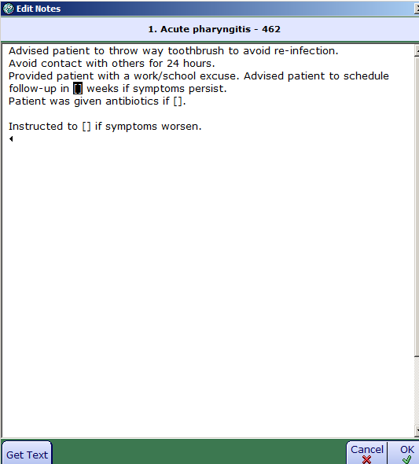
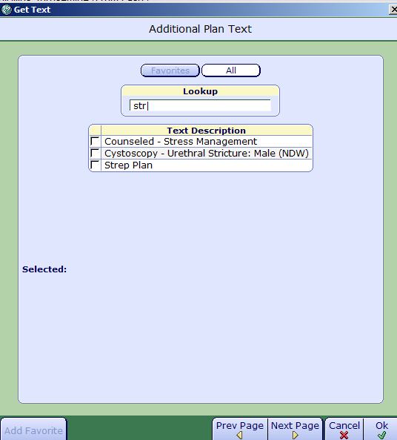
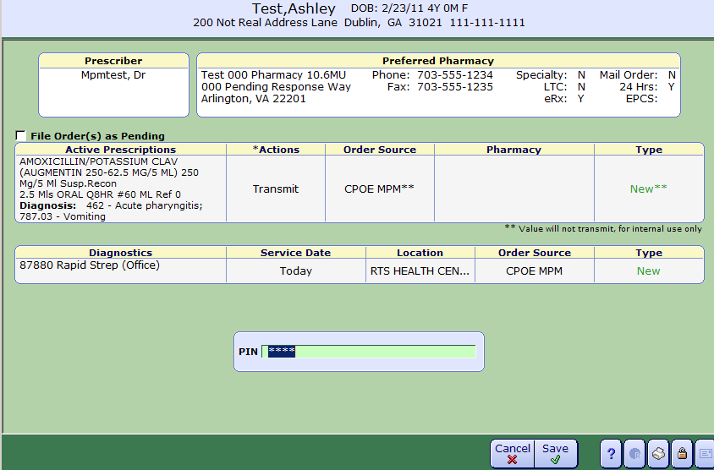
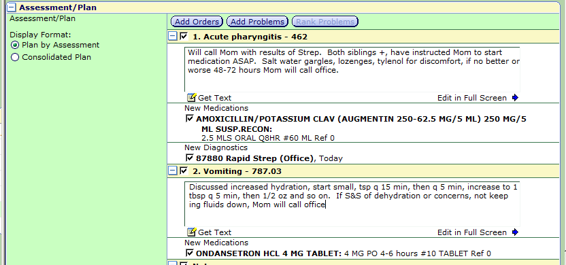
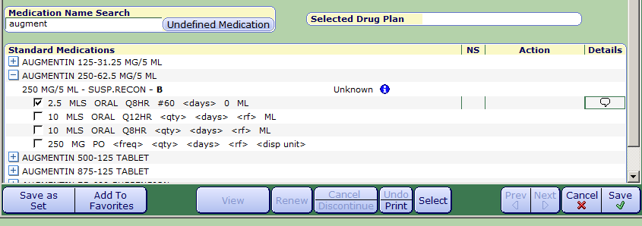
Slide headline
Solving for Today. Preparing for Tomorrow.
Confidential © 2014 Galen Healthcare Solutions
Notes:
Once all orders are completed, we’ll click Save. DUR (drug utilization review) will occur and if any interactions or allergies an alert will pop up. If not the pharmacy screen and pin entry window will open. If necessary enter in the patient preferred pharmacy, enter in PIN and click Save. Clicking Save will send the medications to the pharmacy, enter any orders for diagnostics into the system and trigger any system generated tasks . Clicking Save will also bring us back to the Plan section of our note
As you can see, our orders are now under the diagnoses associated with them, and we have also free texted some documentation into our plan under each diagnosis. In addition to free text, we can also use Dragon or use the “get text” functionality which opens a Get Text window which allows access to the “Canned Text” documentation. Search for the appropriate Plan text, click the box next to the text we wish to use, you will then have the opportunity to edit and personalize to the patient as needed. Once any editing is completed, we would click ok and be brought back to our Plan,

Slide 34
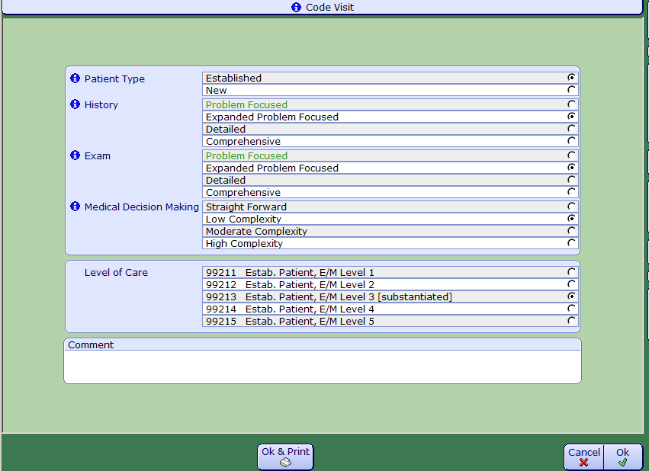
Slide headline
Solving for Today. Preparing for Tomorrow.
Coding the Visit
Confidential © 2014 Galen Healthcare Solutions
Notes:
Coding the Visit
There are two ways to code the visit. Coding can be completed from within the Note or by using the Coding Worklist button located on the Schedule Desktop.
First we will discuss coding the visit from within the note.
Click the Code Visit button. The Code Visit window will pop up
Review the code levels determined by the E/M coder based on your documentation. Keep in mind that the Coder does not pick up free text, so the level of care substantiated may be different than the actual level of care.
Make changes as needed. Ultimately the decision making is performed by the provider.
Select your Level; of Care.
Click OK
Clicking OK will bring you back to your note. If documentation is complete you can sign the note, if not, Save as in Process. Once you click on Record List you’ll be back at your schedule

Slide 35
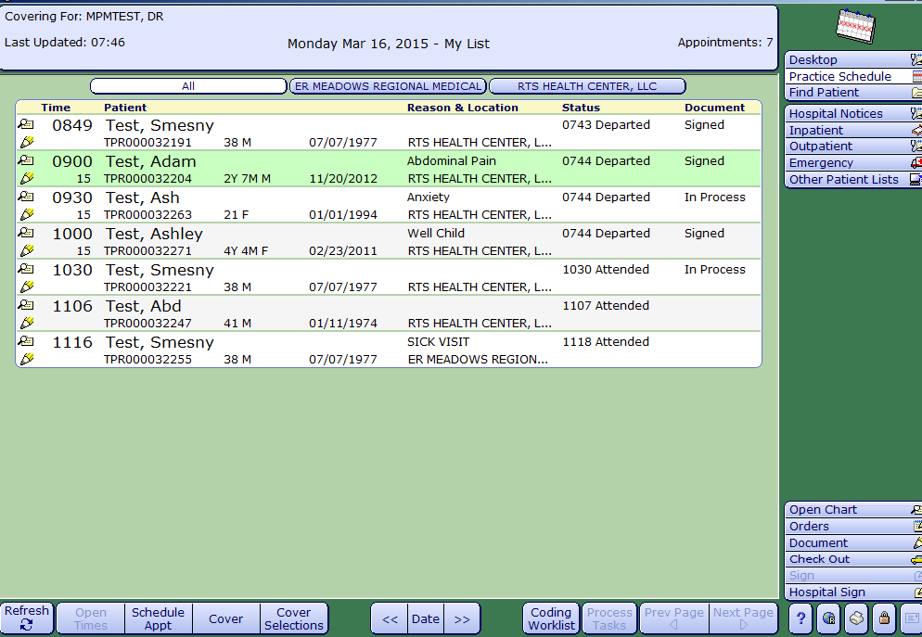
Slide headline
Solving for Today. Preparing for Tomorrow.
Confidential © 2014 Galen Healthcare Solutions
Notes:
While we are on practice schedule screen and before I get into the second way to Code for the visit, I wanted to bring up a question that occurs frequently, mainly during the first few days of a go live. Almost every provider asks, how do I know if I have signed all of my notes. Two ways, first, on the physician schedule there is a column with the header of Document. Within this column will show the status of the notes as either In Process or Signed. (for midlevels that need cosign, you will see I Signed as a status))

Slide 36
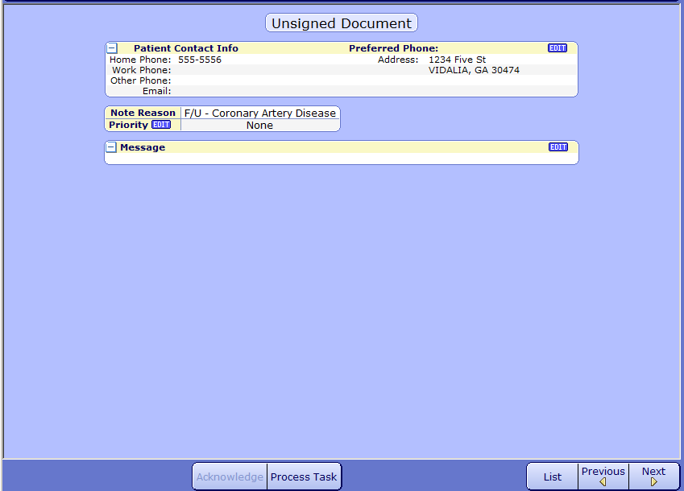
Slide headline
Solving for Today. Preparing for Tomorrow.
Confidential © 2014 Galen Healthcare Solutions
Notes:
Second, they will have an “incomplete document” task if a note is unsigned. When the task is opened it provides the unsigned document information and a Process Task (click x2)button which will bring them to the Template that needs signature.

Slide 37

Slide headline
Solving for Today. Preparing for Tomorrow.
Confidential © 2014 Galen Healthcare Solutions
Notes:
Right behind the how do I know if I signed my note question, I get, if I have signed my note and have forgotten to Code my visit, how do I code? As I mentioned earlier, there is a way to code the visit from the schedule. By clicking the Coding Worklist Button, the Code visit Worklist will open and will show the appts for the session, whether they were processed thru the visit using the E/M coder, and any additional codes associated with the visit. Some providers prefer coding this way as in addition to entering their level of care for the visit, they can also see whatever CPT codes from tests or med admins have dropped for the visit. They also can code all patients at once which again, can be a preference for some.
I will now hand things over to Kim to finish up our patient visit process with any checkout or ambulatory tasks that need to be completed.

Slide 38

Slide headline
Solving for Today. Preparing for Tomorrow.
Confidential © 2014 Galen Healthcare Solutions
Notes:
Depending on the workflow for your office, the role of the person responsible for checking any outstanding order tasks before the patient is departed might vary. How many are used to the provider sticking their head out the door and asking for assistance. Well the nurse can easily check for any orders such as injections or labs that the provider has ordered during the visit.
One the desktop Most check out tasks will be under the Orders section. However, an order for an administration of injection might be listed under the Incomplete section as it is waiting on the administration to be charted.
Lets look at how to satisfy these orders. We will start with the Follow Up appt task.

Slide 39


Slide headline
Solving for Today. Preparing for Tomorrow.
Confidential © 2014 Galen Healthcare Solutions
Notes:
To attend to a task, the user will select the task, and a window will open showing the options available for this task. This task shown for a follow up appointment is pretty straight forward. The option for this task is Process Task or return to the list. We will process this task.

Slide 40

Slide headline
Solving for Today. Preparing for Tomorrow.
Confidential © 2014 Galen Healthcare Solutions
Notes:
Once the Process Task option is selected a process task window opens. The action options are now listed under the details (click) column above. As you can see, there are other outstanding tasks for this patient. The task we are concerned with is the last one listed and it has an action of Verify. The verify task basically just needs someone to acknowledge it to clear it. When the Verify is selected (click) the task automatically goes into a completed status.

Slide 41


Slide headline
Solving for Today. Preparing for Tomorrow.
Confidential © 2014 Galen Healthcare Solutions
Notes:
The next example we have is processing a Checkout Ambulatory Order – typically this is for either the lab technician or the nurse to process. When the action item under details is selected (Req’d Queries) a separate window pops up with the missing questions that is needing for processing this order. Once the questions are answered and saved, the task then goes to the next status and in this instance it is Processed. Then you would save and the system takes you back to the original task. Select “LIST” to go back to the desktop. Another status might be RESULTS, this would move the task into an Incomplete Ambulatory Order section of the desktop to await the resulting of the item.

Slide 42


Slide headline
Solving for Today. Preparing for Tomorrow.
Confidential © 2014 Galen Healthcare Solutions
Notes:
Next we will quickly look at how to generate a Visit Summary. From the schedule, clinical desktop you will need to be in the patient chart. On the right you will see the Check out option.
From the Scheduler Desktop, it will depend what view you are in. (Click) For example from the Practice View you will have a button for Check in/Out. However if the Patient View, you will have an option to open chart and follow the same process as shown previously.

Slide 43

Slide headline
Solving for Today. Preparing for Tomorrow.
Confidential © 2014 Galen Healthcare Solutions
Notes:
From the patient chart, you will brought to the Encounter screen. You will select the encounter you wish to print the visit summary for. Highlight the encounter and select OK.
However, if launched from the scheduling view, you will already have the encounter in context so you will not see this screen.

Slide 44

Slide headline
Solving for Today. Preparing for Tomorrow.
Confidential © 2014 Galen Healthcare Solutions
Notes:
You will then be brought to the Check Out Window. At the top you see my user has the options to generate a Visit Summary and Immunization History.
At the bottom the footer buttons give you more options.
-New appointment for the patient.
-Schedule a hospital appt ( if your facility allows this),
-Add patient education
-Depending on your role/security you might have an option for future appts, cash drawer, send to portal, etc.
-Print, Print Depart or Depart. (Depart Patient might be used in the case you send documents to the portal and do not have the need to print them.

Slide 45


Slide headline
Solving for Today. Preparing for Tomorrow.
Confidential © 2014 Galen Healthcare Solutions
Notes:
This is an example of the screen comes up when choosing to schedule a new practice appointment. After selecting the appropriate options you will be launched into the PATIENT scheduler desktop.

Slide 46


Slide headline
Solving for Today. Preparing for Tomorrow.
Confidential © 2014 Galen Healthcare Solutions
Notes:
Here is a view of the screen that pops up when selecting to add Patient Education. Here I have chosen an education item to be added to the documents to be printed for this patient. As you can see the item was added to the list of check out material.

Slide 47


Slide headline
Solving for Today. Preparing for Tomorrow.
Confidential © 2014 Galen Healthcare Solutions
Notes:
Once you select print you will be presented with a print destination box. You can select your printer click ok, and print your documents. You can also Preview the documents before printer if needed. You will get the documents on your desktop and the MEDITECH document manager window. Within this window is an option to print also. From here it will print to your local/default printer.

Slide 48

Thank you for joining us today.
To access the slides from today’s presentation, as well as our past webcasts, please visit:
http://wiki.galenhealthcare.com/Category:Webcasts
For additional assistance or to request information about our many services and products, please contact us through our website:
www.galenhealthcare.com
Notes:
This brings us to the conclusion of our Webcast on MEDITECH MPM 101.. We will leave the Q & A panel open for a few more moments for questions. The slides from today’s presentation along with any questions and answers will be available on the galen wiki within the next few days. It looks like we have a couple of questions that have come in.
Looks like that is it for questions. We will leave the Q and A panel open for a few more moments to capture any additional questions.
We would like to Thank you all for your time today and wish you all a fantastic weekend!

